Slide 1

Stats Bootcamp
MSc in Analytics
Dr. Anil D Chaturvedi
Email: anilchaturvedi@uchicago.edu
Phone: 301-299-2434

Slide 2
Welcome to Stats Bootcamp

Slide 3
Session 2: Topics
Complete conversation on Skewness Kursotis and Bivariate associations.
Concept of Probability
Bayes Theorem
Common Theoretical Distributions
Concept of the Sampling Distribution

Slide 4
Measuring Skew and Kurtosis
Distributions can vary in:
skew
kurtosis
Notes:
We saw in the section on distributions that shapes of distributions can differ in skew and/or kurtosis. This section presents numerical ways of measuring these two attributes of shape.

Slide 5
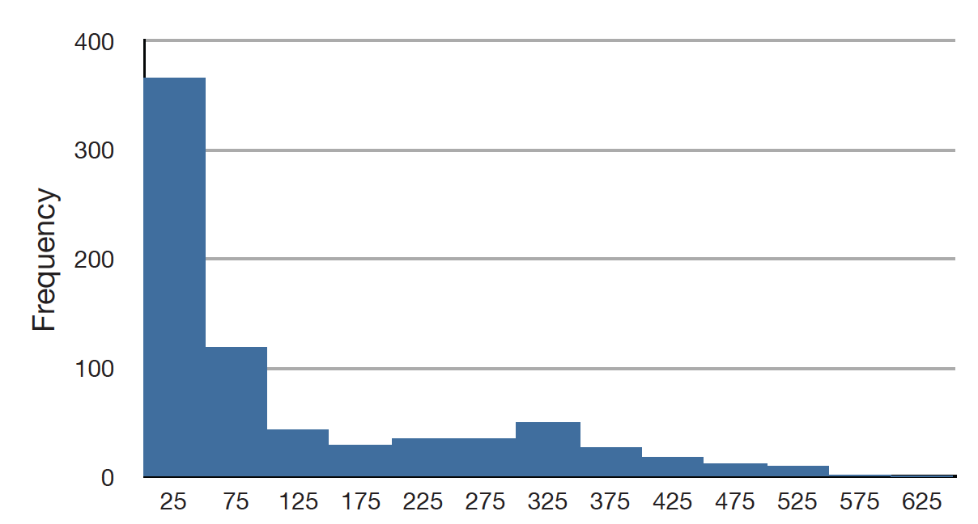
Positive Skew
Notes:
This figure shows a distribution with a very large positive skew. Recall that distributions with positive skew have tails that extend to the right.

Slide 6
Positive Skew
The mean is larger than the median.
Notes:
Distributions with positive skew have larger means than medians. The mean and median of the baseball salaries shown in this figure are $1,183,417 and $500,000 respectively (each unit on the x axis represents $10,000). For this highly-skewed distribution, the mean is more than twice as high as the median.

Slide 7
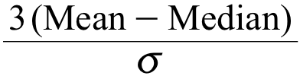
Pearson’s Measure of Skew
Notes:
The relationship between skew and the relative size of the mean and median led the statistician Karl Pearson to propose this simple and convenient numerical way of measuring skew. Remember that lower case sigma represents the standard deviation. Verbally, this formula reads, “three times the difference between the mean and median divided by the standard deviation.”

Slide 8
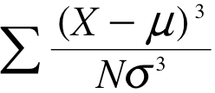
Third Moment
Notes:
Just as there are several measures of central tendency, there is more than one measure of skew. Although Pearson's measure is a good one, the measure shown here is more commonly used. This measure is sometimes referred to as the third moment about the mean. Remember, upper case sigma represents summation, X represents an individual raw score, mu represents the population mean, and lower case sigma represents the standard deviation.

Slide 9
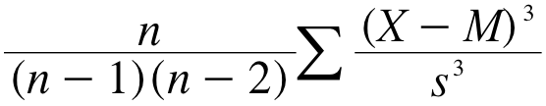
Estimating Skew
Notes:
Use this formula when estimating the skew where n is the sample size. M is the sample mean, and s is the sample standard deviation.

Slide 10
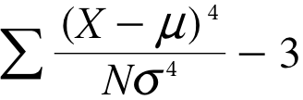
Kurtosis
Notes:
This measure of kurtosis is the fourth moment about the mean. The value "3" is subtracted to define "no kurtosis" as the kurtosis of a normal distribution. Otherwise, a normal distribution would have a kurtosis of 3.

Slide 11
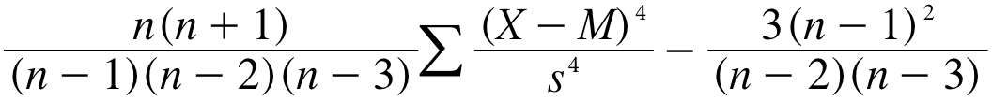
Estimating Kurtosis
Notes:
Although you will probably never have to estimate kurtosis by hand, this is the formula you would use. Most statistics programs and spreadsheets use this formula to estimate kurtosis.

Slide 12
Effect of Linear Transformations
Measures of central tendency
Variability
Notes:
This section covers the effect of linear transformations on measures of central tendency and variability.

Slide 13
Introduction to Bivariate Data
Measures of central tendency, variability, and spread summarize a single variable by providing important information about its distribution
Notes:
Measures of central tendency, variability, and spread summarize a single variable by providing important information about its distribution.

Slide 14


Males
Memory
Span
Females
Memory
Span
Randomly Paired
thus are Independent
Notes:
In the memory span example, we have thousands of randomly-paired scores. Since the scores are paired randomly, there is no relationship between memory span of one member of the pair and the memory span of the other. Therefore the two scores are independent.

Slide 15
Verbal
SAT
Quantitative
SAT
Relationship Between
the Two Variables
Notes:
Contrast this situation with one in which thousands of people are sampled and two measures, such as verbal and quantitative SAT, are taken from each. In this case, there would be a relationship between the two variables since higher scores on the verbal SAT are associated with higher scores on the quantitative SAT.

Slide 16
Not
Independent
Verbal
SAT
Quantitative
SAT
Relationship Between
the Two Variables
Notes:
Thus the two variables are not independent and the variance of the total SAT score would not be the sum of the variance of the verbal SAT and the quantitative SAT. The general form of the variance sum law that takes non-independence into account is presented in a section in the chapter on correlation.

Slide 17
What are Bivariate Data?
Bivariate data consists of data on two variables.
Usually we are interested in the relationship between the variables.
Notes:
In this chapter we consider bivariate data which consists of two quantitative variables for each individual.

Slide 18
Spousal Age Example
Let’s consider something with which we are all familiar: age.
Notes:
Our first interest is in summarizing such data in a way that is analogous to summarizing data on a single variable. By way of illustration, let’s consider something with which we are all familiar: age. It helps to discuss something familiar since knowing the subject matter goes a long way goes a long way in making judgments about statistical results.

Slide 19
Spousal Age Example
Do people tend to marry other people of the same age?
Our experience tells us “yes,” but how good is the correspondence?
Notes:
Let’s begin by asking if people tend to marry other people of about the same age. Our experience tells us “yes,” but how good is the correspondence?

Slide 20
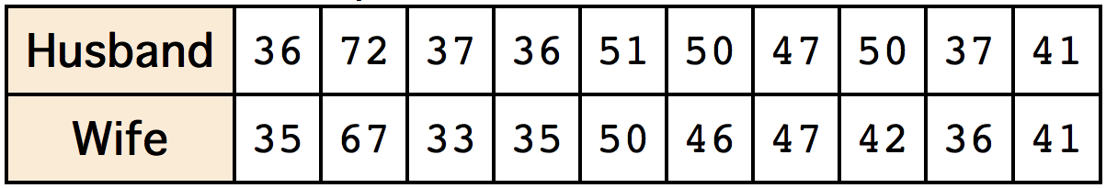
Spousal Age Example
One way to address the question is to look at pairs of ages for a sample of married couples.
The table shows the ages of 10 married couples.
Notes:
One way to address the question is to look at pairs of ages for a sample of married couples. The table shows the ages of 10 married couples.

Slide 21
Spousal Age Example
Husbands and wives tend to be about the same age
Men having a tendency to be slightly older than their wives.
Notes:
Going across the columns we see that, yes, husbands and wives tend to be of about the same age, with men having a tendency to be slightly older than their wives. This is no big surprise, but at least the data bear out our experiences, which is not always the case. The pairs of ages in the table are from a dataset consisting of 282 pairs of spousal ages, too many to make sense of from a table.

Slide 22
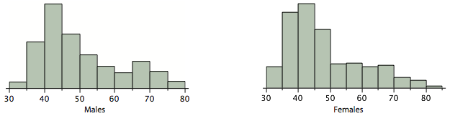
Spousal Age Example
Notes:
What we need is a way to summarize the 282 pairs of ages. We know that each variable can be summarized by a histogram and by a mean and standard deviation. Each distribution is fairly skewed with a long right tail. Although some wives are older than their husbands, this information cannot be determined from the histograms or from the means and standard deviations.

Slide 23
Unavailable Information
Mean age of husbands with wives of a certain age.
The average age of husbands with 45-year-old wives.
The relationship between the husband’s age and the wife’s age.
Notes:
Another example of information not available from the separate descriptions of husbands and wives’ ages is the mean age of husbands with wives of a certain age. For instance, what is the average age of husbands with 45-year-old wives? Finally, we do not know the relationship between the husband’s age and the wife’s age.

Slide 24
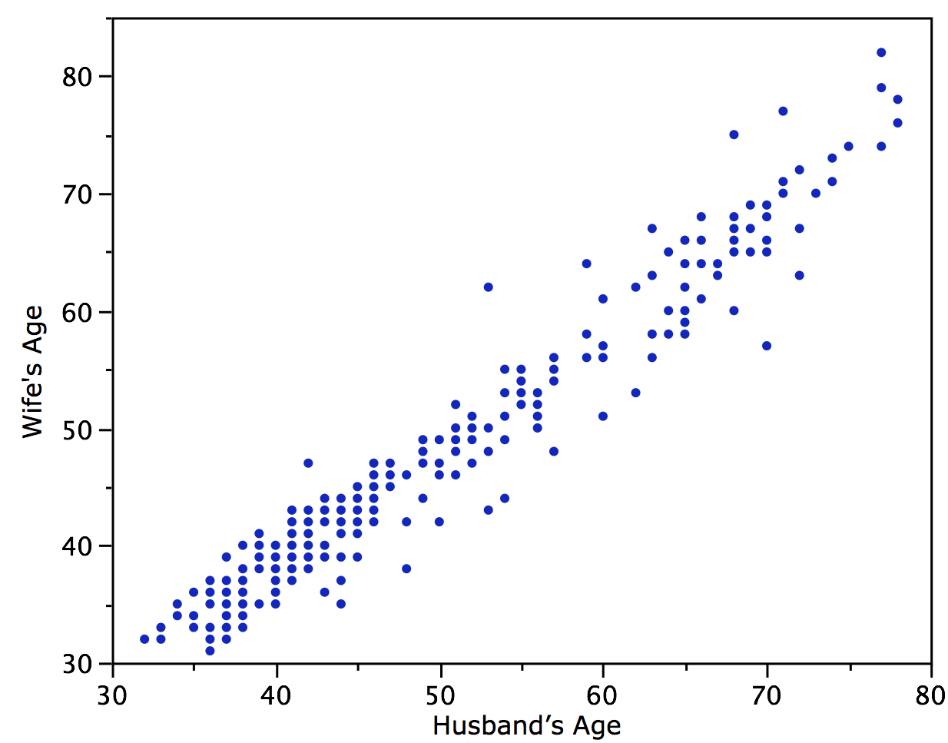
Notes:
We can learn much more by displaying the bivariate data in a graphical form that maintains the pairing. The figure shows a scatter plot of the paired ages. The x-axis represents the age of the husband and the y-axis the age of the wife. Each blue dot represents one married couple. The graph shows clearly that there is a strong relationship between the husband’s age and the wife’s age: the older the husband, the older the wife

Slide 25
Associations
When one variable increases with the second variable, there is a positive association.
When one variable decreases with the second variable, there is a negative association.
Notes:
When one variable (Y) increases with the second variable (X), there is a positive association between X and Y. Conversely, when Y decreases as X increases, there is a negative association.

Slide 26
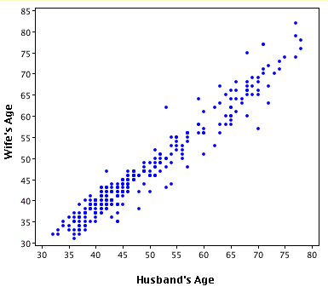
Notes:
A second characteristic of these data is that the points cluster along a straight line. When this occurs, the relationship is called a linear relationship.

Slide 27
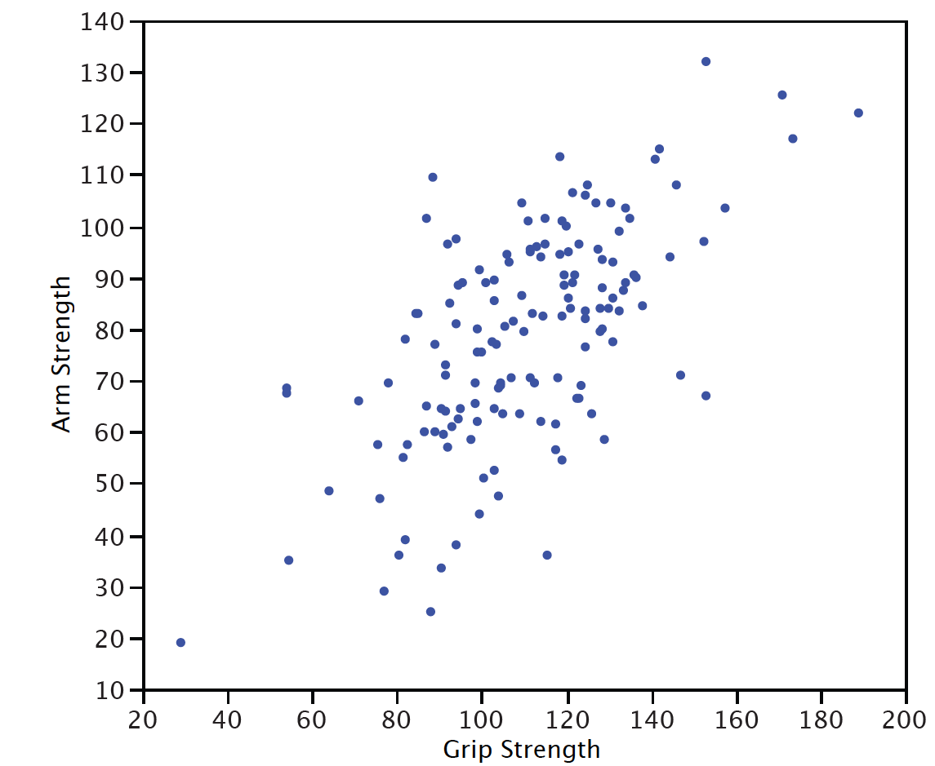
Notes:
This figure shows a scatter plot of Arm Strength and Grip Strength from 149 individuals working in physically demanding jobs including electricians, construction and maintenance workers, and auto mechanics. Not surprisingly, the stronger someone’s grip, the stronger their arm tends to be. There is therefore, a positive association between these variables.
Although the points cluster along a line, they are not clustered quite as closely as they are for the scatter plot of spousal age.

Slide 28
Ways Scatter Plots Can Differ
The slope of the line about which they cluster
How tightly the points cluster about the line
Notes:
Scatter plots that show linear relationships between variables can differ in several way including the slope of the line about which they cluster and how tightly the points cluster about the line. A statistical measure of the strength of the relationship between variables that takes both these factors into account is the subject of another section.

Slide 29
Pearson Product-Moment Correlation
Strength of the linear relationship between two variables.
It is referred to as Pearson’s correlation or the correlation coefficient.
Notes:
The Pearson product-moment correlation coefficient is a measure of the strength of the linear relationship between two variables. It is referred to as Pearson’s correlation or simply as the correlation coefficient.

Slide 30
Not Adequate for Nonlinear
Notes:
If the relationship between the variables is not linear, then the correlation coefficient does not adequately represent the strength of the relationship between the variables. Recall that a relationship is linear if the points cluster around a straight line. The figure shows a nonlinear relationship.

Slide 31
Symbols for Pearson’s Correlation
Greek letter ρ for the population
r for a sample
Notes:
The symbol for Pearson’s correlation is “rho” when it is measured in the population and “r” when it is measured in a sample. Because we will be dealing almost exclusively with samples, we will use r to represent Pearson’s correlation unless otherwise noted.

Slide 32
Values of the Pearson Correlation
Range: -1 to 1
-1: perfect negative relationship
0: no linear relationship
1: perfect positive relationship
Notes:
Pearon’s r can range from -1 to 1. An r of -1 indicates a perfect negative linear relationship between variables, an r of 0 indicates no linear relationship between variables and an r of 1 indicates a perfect positive relationship between variables.

Slide 33
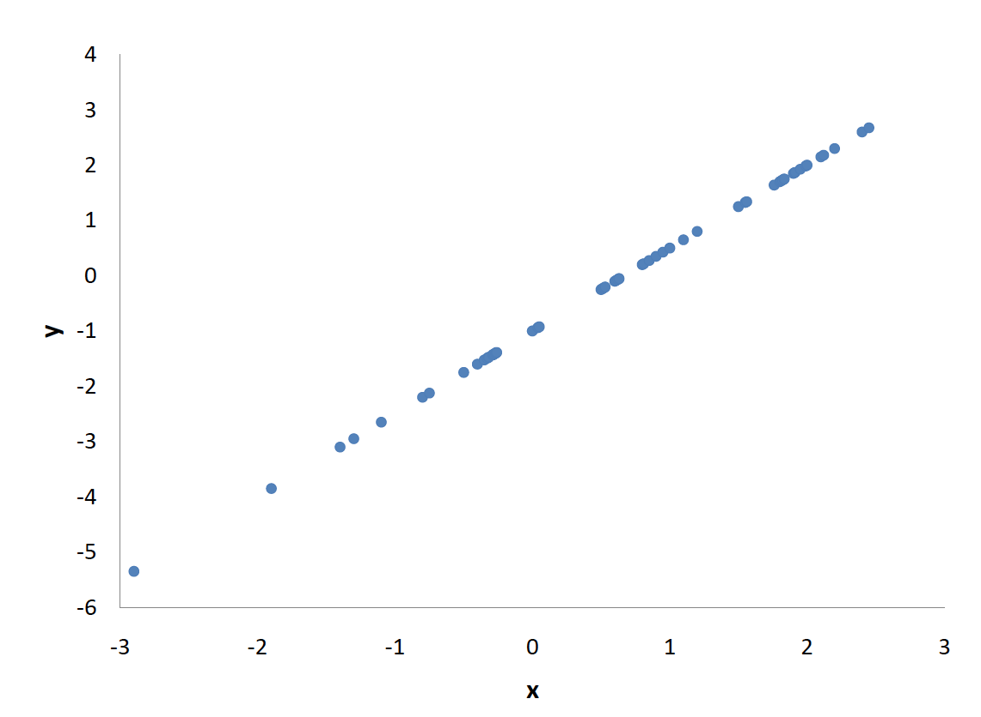
Perfect Linear Relationship
Notes:
The figure shows a scatter plot for which r = 1. Notice that the points fall on a straight line.

Slide 34
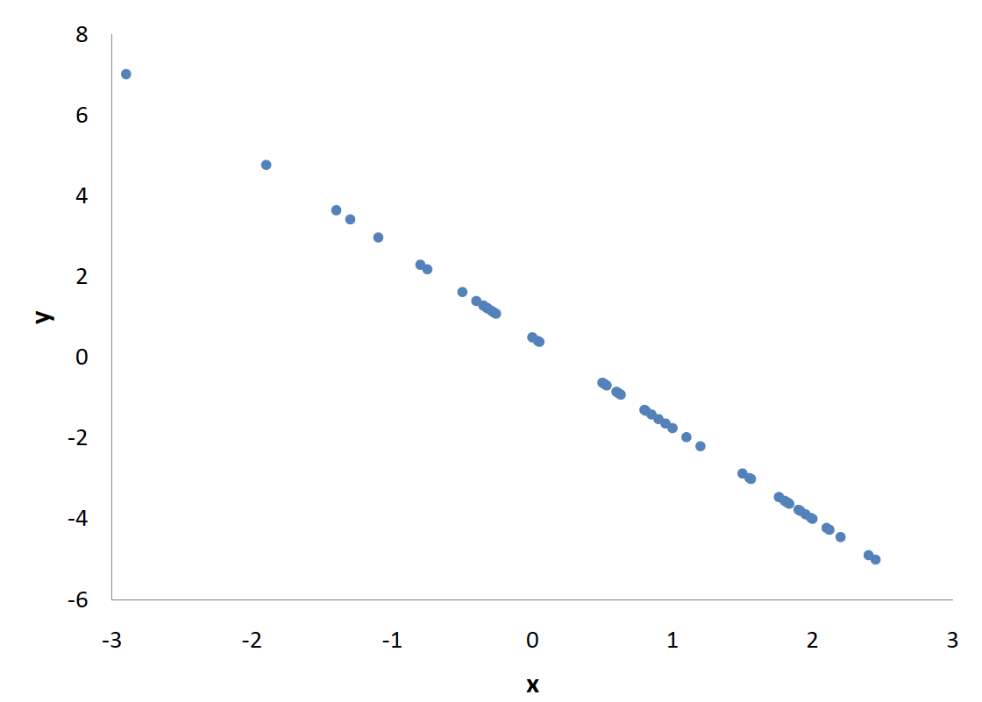
Perfect Negative Relationship
Notes:
The figure shows a perfect negative linear relationship. Notice that as X increases, Y decreases.

Slide 35
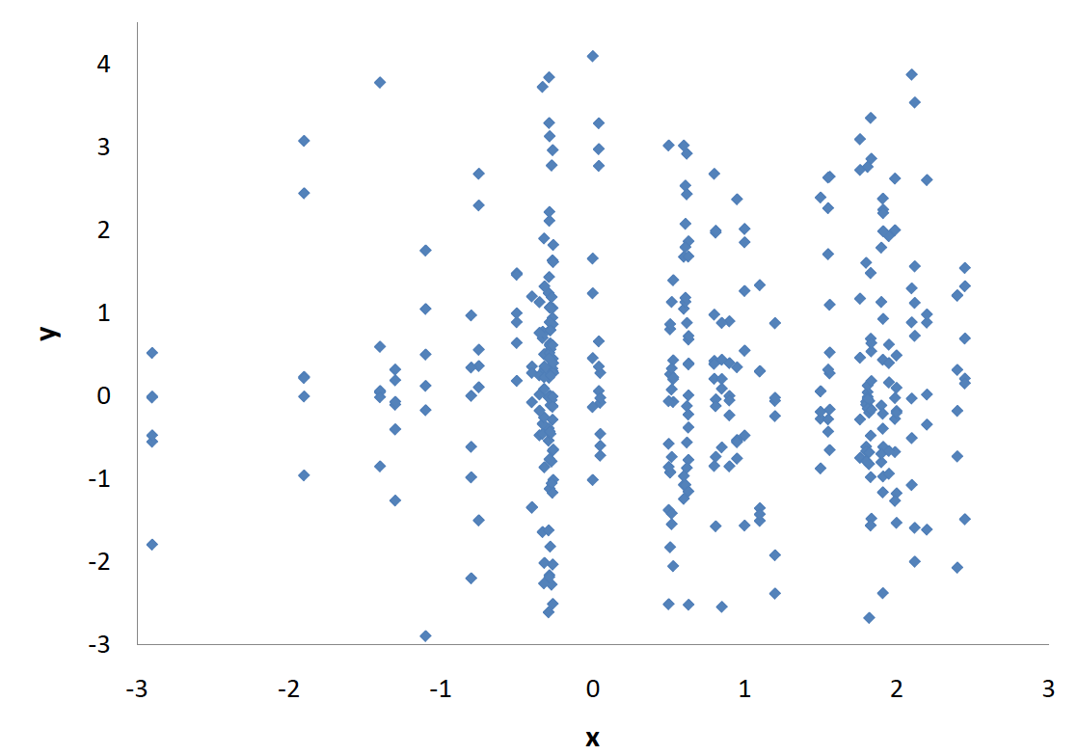
No Linear Relationship
Notes:
The figure shows a scatter plot for which r=0. Notice that there is no relationship between X and Y.

Slide 36
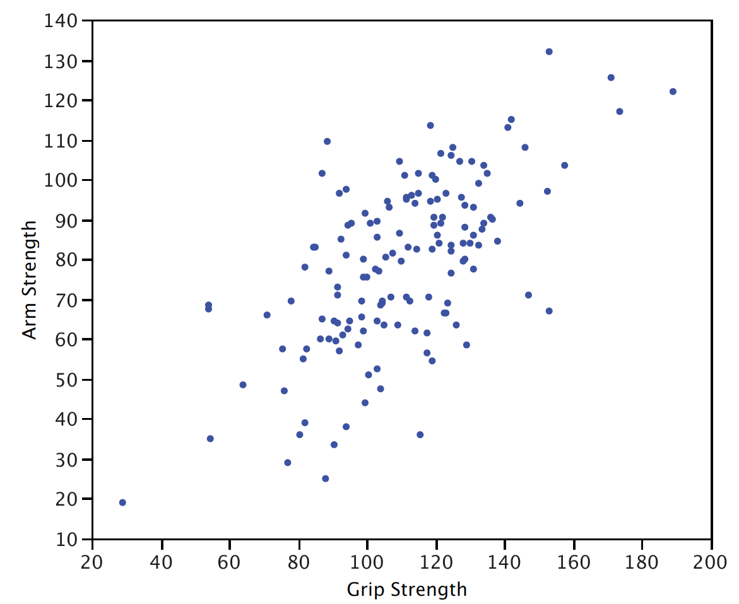
Notes:
For real data, perfect realtionships are rare to non-existent. This figure shows the relationship between grip strength and arm strength for a sample of workers in physically demandint jobs. The value of Pearson’s correlation is 0.63.

Slide 37
Range of Pearson’s r
-1 for a perfect negative linear relationship
0 for no linear relationships
1 for a perfect positive linear relationship
Notes:
A basic property of Pearson’s r is that its possible range is from -1 to 1. The lowest possible correlation of -1 means there is a perfect negative linear relationship, a correlation of 0 means no linear relationship and the highest possible correlation of 1 means there is a perfect linear relationship.

Slide 38
Symmetry
The correlation of Weight with Height is the same as the correlation of Height with Weight.
Notes:
Pearson’s correlation is symmetric in the sense that the correlation of X with Y is the same as the correlation of Y with X. For example, the correlation of Weight with Height is the same as the correlation of Height with Weight.

Slide 39
Unaffected by positive Linear Transformations
Multiplying a variable by a positive constant and/or adding a constant does not change the correlation of that variable with other variables.
Notes:
A critical property of Pearson’s r is that it is unaffected by linear transformations. This means that multiplying a variable by a constant and/or adding a constant does not change the correlation of that variable with other variables.

Slide 40
Unaffected by Positive Linear Transformations
The correlation of Weight and Height does not depend on whether Height is measured in inches, feet, or even miles.
Notes:
For instance, the correlation of Weight and Height does not depend on whether Height is measured in inches, feet, or even miles.

Slide 41
Unaffected by Linear Transformations with positive slope
Adding five points to every student’s test score would not change the correlation of the test score with other variables such as GPA
Notes:
Similarly, adding five points to every student’s test score would not change the correlation of the test score with other variables such as grade point average.

Slide 42

Computing Pearson’s r
Several formulas that can be used to compute Pearson’s correlation
Some formulas make more conceptual sense and others are easier to actually compute
Notes:
There are several formulas that can be used to compute Pearson’s correlation. Some formulas make more conceptual sense whereas others are easier to actually compute. We are going to begin with a formula that makes more conceptual sense.

Slide 43
Computing Pearson’s r
 | X | Y | x | y | xy | x² | y²
 | 1 | 4 | -3 | -5 | 15 | 9 | 25
 | 3 | 6 | -1 | -3 | 3 | 1 | 9
 | 5 | 10 | 1 | 1 | 1 | 1 | 1
 | 5 | 12 | 1 | 3 | 3 | 1 | 9
 | 6 | 13 | 2 | 4 | 8 | 4 | 16
Total | 20
Mean | 4
Notes:
We are going to compute the correlation between the variables X and Y shown in the table. We begin by computing the total for X which is the first column. This total of 20 is then divided by the sample size of 5 to get the mean of 4.

Slide 44
Computing Pearson’s r
 | X | Y | x | y | xy | x² | y²
 | 1 | 4 | -3 | -5 | 15 | 9 | 25
 | 3 | 6 | -1 | -3 | 3 | 1 | 9
 | 5 | 10 | 1 | 1 | 1 | 1 | 1
 | 5 | 12 | 1 | 3 | 3 | 1 | 9
 | 6 | 13 | 2 | 4 | 8 | 4 | 16
Total | 20 |  | 0
Mean | 4 |  | 0
Notes:
We then subtract this mean from each value of X to produce the third column (small x). Notice that the mean of small x is 0.

Slide 45
Computing Pearson’s r
 | X | Y | x | y | xy | x² | y²
 | 1 | 4 | -3 | -5 | 15 | 9 | 25
 | 3 | 6 | -1 | -3 | 3 | 1 | 9
 | 5 | 10 | 1 | 1 | 1 | 1 | 1
 | 5 | 12 | 1 | 3 | 3 | 1 | 9
 | 6 | 13 | 2 | 4 | 8 | 4 | 16
Total | 20 | 45 | 0 | 0
Mean | 4 | 9 | 0 | 0
Notes:
We do the same thing for Y to create the column small y. The variables small x and small y are deviation scores because each score is a deviation from its mean.

Slide 46
Computing Pearson’s r
 | X | Y | x | y | xy | x² | y²
 | 1 | 4 | -3 | -5 | 15 | 9 | 25
 | 3 | 6 | -1 | -3 | 3 | 1 | 9
 | 5 | 10 | 1 | 1 | 1 | 1 | 1
 | 5 | 12 | 1 | 3 | 3 | 1 | 9
 | 6 | 13 | 2 | 4 | 8 | 4 | 16
Total | 20 | 45 | 0 | 0 | 30 | 16 | 60
Mean | 4 | 9 | 0 | 0 | 6
Notes:
Next we create a column by multiplying small x and small y together. This column is caled “xy” Finally, we create two new columns, one is the square of small x and the other is the square of small y.

Slide 47
Computing Pearson’s r
 | X | Y | x | y | xy | x² | y²
 | 1 | 4 | -3 | -5 | 15 | 9 | 25
 | 3 | 6 | -1 | -3 | 3 | 1 | 9
 | 5 | 10 | 1 | 1 | 1 | 1 | 1
 | 5 | 12 | 1 | 3 | 3 | 1 | 9
 | 6 | 13 | 2 | 4 | 8 | 4 | 16
Total | 20 | 45 | 0 | 0 | 30 | 16 | 60
Mean | 4 | 9 | 0 | 0 | 6
Notes:
Before proceeding with the calculations, let’s consider why the mean of the xy column reveals the relationship between X and Y. If there were no relationship between X and Y, then positive values of small x would be just as likely to be paired with negative values of small y as with positive values. This would make negative values of xy as likely as positive values and the sum would be 0. On the other hand, consider the example data shown here where high values of X are associated with high values of Y and low values of X are associated with low values of Y. You can see that positive values of small x are associated with positive values of small y and negative values of small x are associated with negative values of small y. Therefore, the values of xy are positive. If high values of X were associated with low values of Y, then xy would be negative.

Slide 48

The Formula
The resulting formula is:
Notes:
Pearson’s correlation is computed by dividing the sum of the xy column by the square root of the product of the sum of the x squared column and the sum of the y squared column. For this example, r = 0.968.

Slide 49
Computational Formula
Notes:
An alternative computational formula that avoids the step of computing deviation scores is shown here. This is a good formula to use in the remote possibility that you are computing r using a hand calculator.

Slide 50
Variance of the Sum of Two Variables
You have two populations.
You sample one number from each.
You add the two numbers.
Repeat many times
What is the variance of the sums?
Notes:
In this section, we will discuss how to calculate the variance of the sum of two variables. As you will see in later sections, there are many occasions where this is important. Consider the following situation: you have two populations, you sample one number from each population, and then you add the two numbers together. You do this over and over again until you have a great many sums. The question is, "What is the variance of the sums."

Slide 51

Variance of the Sum of Two Variables
Houston
Males
Memory
Span
+
Females
Memory
Span
Notes:
For example, suppose the two populations are the populations of 8-year old males and 8-year females in Houston Texas and that the variable of interest is memory span. You repeat the following steps thousands of times: (1) sample one male and one female, (2) measure the memory span of each, and (3) add the two memory spans.

Slide 52
Variance of the Sum
Notes:
After you have done this thousands of times, you compute the variance of the sum. It turns out that the variance of this sum can be computed according to the formula shown here.
The first term is the variance of the sum, the second term is the variance of the males and the third term is the variance of the females.

Slide 53
Variance of the Sum
Notes:
Therefore, if the variances on the memory span test for the males and females respectively were 0.9 and 0.8, then the variance of the sum would be 1.7.

Slide 54
Variance of the Difference
Notes:
The formula for the variance of the difference between the two variables (memory span in this example) is shown here. Notice that expression for the difference is the same as the formula for the sum. Intuitively you might think that the variance of the difference would be smaller but that is not the case.

Slide 55
Variance Sum Law
Notes:
More generally, the variance sum law can be written as shown here.
This is read as
"The variance of X plus or minus Y is equals the variance of X plus the variance of Y.

Slide 56
Variance Sum Law
If X and Y are Independent
Notes:
Recall that when the variables X and Y are independent, the variance of the sum of X and Y is the variance of X plus the variance of Y. The variance of X minus Y is also the variance of X plus the variance of Y.

Slide 57
Variance Sum Law
If X and Y are Independent
If X and Y are Correlated
Notes:
When X and Y are correlated, the same formula is used with an additional expression included that accounts for the relationship between the two variables. This expression is the correlation between the two variables, expressed with the symbol rho, times the variance of X times the variance of Y.
So, when the variables are correlated, the variance of X PLUS Y is the variance of X plus the variance of Y plus 2 times rho times the standard deviation of X times the standard deviation of Y.
OR, the variance of X MINUS Y is the variance of X plus the variance of Y MINUS 2 times rho times the standard deviation of X times the standard deviation of Y.

Slide 58
Example Variance of the SAT
σ² verbal SAT: 10,000
σ² quantitative SAT: 11,000
ρ: 0.50
Notes:
For example, let’s examine how we would calculate the variance of the sum or the difference between the verbal and the quantitative scores on the SAT. Assume that the variance for verbal SAT scores is 10,000 and the variance for quantitative SAT scores is 11,000. Also assume that the correlation between these two tests is 0.50.

Slide 59
Example VSAT + QSAT
Notes:
The calculation of the variance of total SAT scores is shown here. It is equal to 31,488.

Slide 60
Example VSAT - QSAT
Notes:
The formula for the DIFFEERENCE between verbal and quantitative SAT is the same as the formula for the sum except that the third term is subtracted instead of added. The variance of the difference for this example is equal to 10,512

Slide 61
Variance Sum Law II
For a population
For a sample
Notes:
If the variance and the correlation are computed in a sample, then the the same formula is used with a different notation to express the variances, correlation and standard deviations.

Slide 62
Probability: Introduction
Notes:
Inferential statistics is built on the foundation of probability theory, and has been remarkably successful in guiding opinion about the conclusions to be drawn from data. Yet (paradoxically) the very idea of probability has been plagued by controversy from the beginning of the subject to the present day. In this section we provide a glimpse of the debate about the interpretation of the probability concept.

Slide 63

Frequentist Approach
If we flipped millions of coins,
we’d expect half of them to come
up heads.
So, we say that the probability of
getting a head is one half.
Notes:
Probabilities can also be thought of in terms of relative frequencies. If we tossed a coin millions of times, we would expect the proportion of tosses that came up heads to be pretty close to 1/2. As the number of tosses increases, the proportion of heads approaches 1/2. Therefore, we can say that the probability of a head is 1/2.

Slide 64

More Weather
A “10% chance of rain”
means that it will rain on 10% of the
days on which rain is forecast
with this probability.
Notes:
The following example illustrates our attitude about probabilities. Suppose you wish to know what the weather will be like next Saturday because you are planning a picnic. You turn on your radio, and the weather person says, “There is a 10% chance of rain.” You decide to have the picnic outdoors and, lo and behold, it rains. You are furious with the weather person. But was she wrong? No, she did not say it would not rain, only that rain was unlikely. She would have been flatly wrong only if she said that the probability is 0 and it subsequently rained. However, if you kept track of her weather predictions over a long periods of time and found that it rained on 50% of the days that the weather person said the probability was 0.10, you could say her probability assessments are wrong.
So when is it accurate to say that the probability of rain is 0.10? According to our frequency interpretation, it means that it will rain 10% of the days on which rain is forecast with this probability.

Slide 65
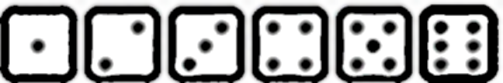
Basic Concepts
Roll a die: there are six possible outcomes
Each outcome is equally likely – so the probability of rolling any number is 1/6.
What is the probability of a 1 or a 6?
Notes:
If you roll a fair six-sided die, there are six possible outcomes, and each of these outcomes is equally likely. A six is as likely to come up as a three, and the same goes for the other four sides of the die. So what is the probability that a one will come up? Since there are six possible outcomes, the probability is 1/6. What is the probability that either a one or a six will come up?

Slide 66
Favorable Outcomes
The outcomes we are interested in (1 or 6) are called favorable outcomes.
Of the six outcomes, two are favorable so the probability is 2/6 = 1/3.
By favorable, we mean favorable to the event in question happening.
Notes:
The two outcomes about which we are concerned (a one or a six coming up) are called favorable outcomes. Given that all outcomes are equally likely, we can compute the probability of a one or a six by dividing the number of favorable outcomes (2 in this case) by the total number of possible outcomes (6 in this case). So the probability of throwing either a one or six is 1/3. Don't be misled by our use of the term "favorable," by the way. You should understand it in the sense of "favorable to the event in question happening." That event might not be favorable to your well-being.

Slide 67
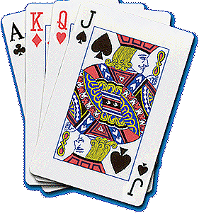
Cards
The same formula also applies to other games of chance.
P(draw an ace) = 4/52 = 1/13
P(draw a club) = 13/52 = 1/4
Notes:
This formula applies to many games of chance. For example, what is the probability that a card drawn at random from a deck of playing cards will be an ace? Since the deck has four aces, there are four favorable outcomes; since the deck has 52 cards, there are 52 possible outcomes. The probability is therefore 4/52 = 1/13. What about the probability that the card will be a club? Since there are 13 clubs, the probability is 13/52 = 1/4.

Slide 68

Bag of Cherries
Say you have a bag of 20 cherries:
14 are sweet and 6 are sour
So, if you pick a cherry at random,
P(sweet) = 14/20 = 7/10. Right?
Notes:
Let's say you have a bag with 20 cherries, 14 sweet and 6 sour. If you pick a cherry at random, what is the probability that it will be sweet? There are 20 possible cherries that could be picked, so the number of possible outcomes is 20. Of these 20 possible outcomes, 14 are favorable (sweet), so the probability that the cherry will be sweet is 14/20 =7/10.

Slide 69
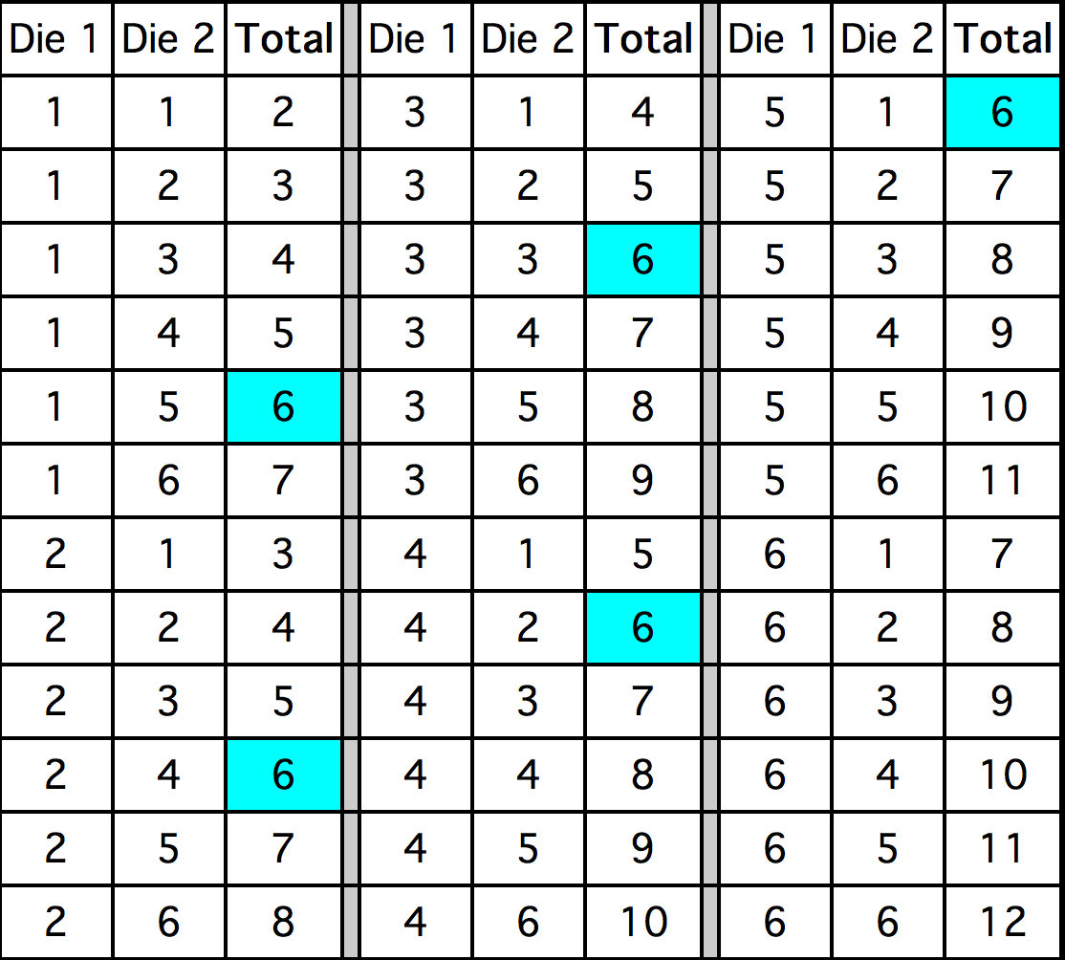
Two Dice that Sum to Six
Notes:
Here is a more complex example. You throw 2 dice. What is the probability that the sum of the two dice will be 6? To solve this problem, list all the possible outcomes. There are 36 of them since each die can come up one of six ways. The 36 possibilities are shown here.
You can see that 5 of the 36 possibilities total 6. Therefore, the probability is 5/36.

Slide 70
Complementary Events
The probability that event A occurs
is written as P(A)
The probability that event A does not occur is then 1-P(A)
So, P(two dice don’t sum to 6)
= 1 - (5/36) = 31/36
Notes:
If you know the probability of an event occurring, it is easy to compute the probability that the event does not occur. If P(A) is the probability of Event A, then 1 - P(A) is the probability that the event does not occur. For the last example, the probability that the total is 6 is 5/36. Therefore, the probability that the total is not 6 is 1 - 5/36 = 31/36.

Slide 71
Independent Events
Events A and B are independent if the probability of event B happening is unaffected by whether event A happens.
Event A = {a fair coin comes up heads on the first toss} and
Event B = {a fair coin comes up heads on the second toss}
Are independent events
Notes:
Events A and B are independent events if the probability of Event B occurring is the same whether or not Event A occurs. Let's take a simple example. A fair coin is tossed two times. The probability that a head comes up on the second toss is 1/2 regard less of whether or not a head came up on the first toss. The two events are (1) first toss is a head and (2) second toss is a head. So these events are independent.

Slide 72
Probability of A and B
If events A and B are independent:
P(A and B) = P(A) x P(B)
Thus, if you flip a coin twice:
P(heads on flip 1 and heads on flip 2)
= (1/2) x (1/2) = 1/4
Notes:
When two events are independent, the probability of both occuring is the product of the probabilities of the individual events. More formally, if events A and B are independent, then the probability of both A and B occuring is:
The probability of A and B is the probability of A times the probability of B
If you flip a coin twice, what is the probability that it will come up heads both times? Event A is that the coin comes up heads on the first flip and Event B is that the coin comes up heads on the second flip. Since both P(A) and P(B) equal 1/2, the probability that both events occur is
1/2 x 1/2 = 1/4

Slide 73
Coin and Die
Event A = {a fair coin comes up Heads}
Event B = {a fair die comes up Six}
Since Events A and B are independent, in an experiment where you flip a coin and then roll a die:
P(Heads and 6) = 1/2 x 1/6 = 1/12
Notes:
Lets take another example. If you flip a coin and roll a six-sided die, what is the probability that the coin comes up heads and the die comes up 6? Since the two events are independent, the probability is simply the probability of a head (which is 1/2) times the probability of the die coming up 6 (which is 1/6). Therefore, the probability of both events occuring is 1/2 x 1/6 = 1/12.

Slide 74

Card Trick
Draw a card from a deck of 52. Put it back. Then draw another.
P(First card is a Heart and Second card is Black) = 1/4 x 1/2 = 1/8
Notes:
One final example: You draw a card from a deck of cards, put it back, and then draw another card. What is the probability that the first card is a heart and the second card is black? Since there are 52 cards in a deck, and 13 of them are hearts, the probability that the first card is a heart is 13/52 = 1/4. Since there are 26 black cards in the deck, the probability that the second card is black is 26/52 = 1/2. The probability of both events occurring is therefore 1/4 x 1/2 = 1/8.

Slide 75
Probability of A or B
If events A and B are independent, then
P(A or B) = P(A)+P(B) – P(A and B)
Note that “A or B” includes:
1) Event A occurs but Event B does not
2) Event A does not occur but Event B does
3) Both Events A and B occur
Notes:
If Events A and B are independent, the probability that either Event A or Event B occurs is:
The probability of Event A occurs plus the probability of Event B occurs minus the probability that both Events A and B occur.
In this discussion, when we say "A or B occurs" we include three possibilities:
A occurs and B does not occur
B occurs and A does not occur
Both A and B occur

Slide 76
Probability of a Head in the First Flip Or the Second Flip
P(Head in 1st or 2nd Flip)
= P(Head in 1st)+P(Head in 2nd)-P(Head in Both)
= 1/2 + 1/2 - 1/4
= 3/4
Notes:
Now for some examples. If you flip a coin two times, what is the probability that you will get a head on the first flip or a head on the second flip (or both)? Letting Event A be a head on the first flip and Event B be head on the second flip then P(A) = 1/2, P(B) = 1/2, and P(A and B) = 1/4. Therefore,
P(A or B) = 1/2 + 1/2 - 1/4 = 3/4.

Slide 77
Return of the Coin and Die
Event A = {a fair coin comes up Heads}
Event B = {a fair die comes up Six}
Since A and B are independent, we get
P(6 or head) = P(6)+P(Head)-P(6 and Head)
= 1/6 + 1/2 - (1/6)(1/2)
= 7/12
Notes:
If you throw a six-sided die and then flip a coin, what is the probability that you will get either a 1 on the die or a head on the coin flip (or both)? The probability is 1/6 + 1/2 minus 1/6 times 1/2. The result is 7/12

Slide 78
Coin and Die III: Negation
Alternatively, note that
P(6 or Head)
= 1-P(not a 6 and not a Head)
= 1- P(not a 6) x P(not a Head)
= 1- (1-1/6)(1-1/2)
= 1- (5/6)(1/2)
= 7/12
Notes:
An alternate approach to computing this value is to start by computing the probability of not getting either a 6 or a head. Then subtract this value from 1 to compute the probability of getting a 6 or a head. Although this is a complicated method, it has the advantage of being applicable to problems with more than two events. Here is the calculation in the present case. The probability of not getting either a 6 or a head can be recast as the probability of
(not getting a 6) AND (not getting a head).
This follows because if you did not get a 6 and you did not get a head, then you did not get a 6 or a head. The probability of not getting a six is 1 - 1/6 = 5/6. The probability of not getting a head is 1 - 1/2 = 1/2. The probability of not getting a six and not getting a head is 5/6 x 1/2 = 5/12. The probability of getting a six or a head is therefore (once again) 1 - 5/12 = 7/12.

Slide 79
P(at least one 6 in three die throws)
P(6 on 1st or 6 on 2nd or 6 on 3rd)
= 1- P(not 6 on 1st and 2nd and 3rd throws)
= 1- (5/6)(5/6)(5/6)
= 1- 125/216
= 91/216
Notes:
If you throw a die three times, what is the probability that one or more of your throws will come up with a 6? That is, what is the probability of getting a 6 on the first throw OR a 6 on the second throw OR a 6 on the third throw? The easiest way to approach this problem is to compute the probability of
NOT getting a 6 on the first throw AND not getting a 6 on the second throw AND not getting a 6 on the third throw.
The answer will be 1 minus this probability. The probability of not getting a 6 on any of the three throws is 5/6 x 5/6 x 5/6 = 125/216. Therefore, the probability of getting a 6 on at least one of the throws is 1 - 125/216 = 91/216.

Slide 80
P(draw two aces from a deck of 52)
By what we have done before:
P(Two Aces)
= P(Ace on 1st Draw) x P(Ace on 2nd Draw)
= 1/13 x 1/13
= 1/169
Is this right?
Notes:
Often it is required to compute the probability of an event given that another event has occurred. For example, what is the probability that two cards drawn at random from a deck of playing cards will both be aces? It might seem that you could use the formula for the probability of two independent events and simply multiply 4/52 x 4/52 = 1/169.

Slide 81
No: There are only 4 Aces in the Deck
The events are not independent:
If the first card drawn is an ace, the probability of getting an ace on the second draw is smaller:
There are only 3 aces left to find in the remaining 51 cards.
Notes:
This would be incorrect, however, because the two events are not independent. If the first card drawn is an ace, then the probability that the second card is also an ace would be lower because there would only be three aces left in the deck.

Slide 82
Conditional Probability
Once the first card is drawn as an Ace, we are interested in the conditional probability that the second card is an ace:
P(Ace on 2nd draw | Ace on 1st draw)
This value is 3/51since there are 3 aces left in the remaining deck of 51
Notes:
Once the first card chosen is an ace, the probability that the second card chosen is also an ace is called the conditional probability of drawing an ace. In this case the "condition" is that the first card is an ace. Symbolically, we write this as shown.
The vertical bar "|" is read as "given," so the above expression is short for "The probability that an ace is drawn on the second draw given that an ace was drawn on the first draw." What is this probability? Since after an ace is drawn on the first draw, there are 3 aces out of 51 total cards left. This means that the probability that one of these aces will be drawn is 3/51 = 1/17.

Slide 83
General Formula
So, if Events A and B are not independent, we can write:
P(A and B) = P(A) x P(B|A)
So P(draw 2 Aces)
= (4/52)(3/51)
= 12/2652 = 1/221.
Notes:
If Events A and B are not independent, then the probability of A and B is the probability of A times the conditional probability of B given A.
Applying this to the problem of two aces, the probability of drawing two aces from a deck is 4/52 x 3/51 = 1/221.

Slide 84

P(Ace of Diamonds and a Black Card)
Draw two cards from the deck. What is the probability of getting the Ace of Diamonds and a Black Card?
Remember, you can get the Ace of Diamonds in either the first draw or the second.
Notes:
One more example: If you draw two cards from a deck, what is the probability that you will get the Ace of Diamonds and a black card? There are two ways you can satisfy this condition: (a) You can get the Ace of Diamonds first and then a black card or (b) you can get a black card first and then the ace of diamonds.

Slide 85
Two Cases
Case A: the first card is the Ace of Diamonds.
P(Case A)
= P(A of D) x P(Black|A of D)
= 1/52 x 26/51 = 1/102
Case B: the second card is the Ace of Diamonds.
P(Case B)
= P(Black) x P(A of D|Black)
= 26/52 x 1/51 = 1/102
Notes:
Let's calculate Case A. The probability that the first card is the Ace of Diamonds is 1/52. The probability that the second card is black given that the first card is the Ace of Diamonds is 26/51 because 26 of the remaining 51 cards are black. The probability is therefore 1/52 x 26/51 = 1/102. Now for Case B: the probability that the first card is black is 26/52 = 1/2. The probability that the second card is the Ace of Diamonds given that the first card is black is 1/51. The probability of Case 2 is therefore 1/2 x 1/51 = 1/102, the same as the probability of Case 1.

Slide 86
Result
Thus, P(Ace of Diamonds and Black)
= P(Case A or Case B)
= P(Case A) + P(Case B) – P(Case A and Case B)
= 1/102 + 1/102 - 0
= 1/51
Notes:
Recall that the probability of A or B is the probability of A plus the probability of B minus the probability of A and B. In this problem, the probability of A and B equals 0 since a card cannot be the Ace of Diamonds and be a black card. Therefore, the probability of Case A or Case B is 1/102 + 1/102 = 2/102. So, 2/102 = 1/51 is the probability that you will get the Ace of Diamonds and a black card when drawing two cards from a deck.

Slide 87

The Infamous Birthday Problem
Suppose there are 25 people in the room. What is the probability that at least two of them share a birthday?
Hint: The answer is not 25/365. It is much larger.
Notes:
If there are 25 people in a room, what is the probability that at least two of them share the same birthday. If your first thought is that it is 25/365 = 0.068, you will be surprised to learn it is much higher than that. This problem requires the application of the sections on P(A and B) and conditional probability.

Slide 88
Reasoning
We should first find the probability that no two people share a birthday.
P1 = P(first person born on any day of year = (1/365+1/365 + …. 365 times) = 365/365 = 1
P2 = P(first two don’t share) = 364/365
P3 = P(3rd doesn’t share | no previous matches) =
= 363/365
Continue like this: P4 = 362/365; P5 = 361/365, and so on up to P25 = 341/365
Notes:
This problem is best approached by asking what is the probability that no two people have the same birthday. Once we know this probability, we can simply subtract it from 1 to find the probability that two people share a birthday.
If we choose two people at random, what is the probability that they do not share a birthday? Of the 365 days on which the second person could have a birthday, 364 of them are different from the first person's birthday. Therefore the probability is 364/365. Let's define P2 as the probability that the second person drawn does not share a birthday with the person drawn previously. P2 is therfore 364/365. Now define P3 as the probability that the third person drawn does not share a birthday with anyone drawn previously given that there are no previous birthday matches. P3 is therefore a conditional probability. If there are no previous birthday matches, then two of the 365 days have been "used up," leaving 363 non-matching days. Therefore P3 = 363/365. In like manner, P4 = 362/365, P5 = 361/365, and so on up to P25 = 341/365.

Slide 89
Solution
The probability can be written as:
P(2nd matches no previous person and 3rd matches no previous person and … and 25th matches no previous person).
That is, P(none of the 25 share a birthday)
= 1- P1*P2 x P3 x P4 x … x P25
= 0.561
It is more likely that not that a birthday is shared.
Notes:
In order for there to be no matches, the second person must not match any previous person and the third person must not match any previous person, and the fourth person must not match any previous person, etc. To find the probability of no matches, all we have to do is multiply P2, P3, P4 up through P25 together. The result is 0.431. Therefore the probability of at least one match is 1 - .431 = 0.561.

Slide 90
The Gambler’s Fallacy
Suppose you flip a fair coin five times, and get heads each time. What is the probability that it will come up heads on the sixth flip?
The answer is, of course 1/2.
Notes:
A fair coin is flipped five times and comes up heads each time. What is the probability that it will come up heads on the sixth flip? The correct answer is, of course, 1/2.

Slide 91
The Gambler’s Fallacy
However, many people incorrectly believe that a tail is more likely.
“In the long run, the number of heads and tails will be the same, so the tails have some catching up to do.”
Notes:
But many people believe that a tail is more likely to occur after throwing five heads. Their faulty reasoning may go something like this "In the long run, the number of heads and tails will be the same, so the tails have some catching up to do." The flaws in this logic are exposed in our simulation on the gambler’s fallacy. In short, the proportion of heads approaches .5 as the number of flips increases. However, the difference between the number of heads and number of tails does not.

Slide 92
Theoretical Distributions

Slide 93
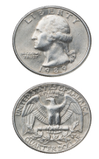
Binomial Distribution
If you flip a fair coin, it will come up heads 1/2 of the time, and tails 1/2 of the time.
What if the coin were biased?
Notes:
When you flip a coin, there are two possible outcomes: heads and tails. Each outcome has a fixed probability, the same from trial to trial. In the case of coins, heads and tails each have the same probability of 1/2. More generally, there are situations in which the coin is biased meaning that heads and tails have different probabilities. In the present section, we consider probability distributions for which there are just two possible outcomes. These distributions are called are called binomial distributions.

Slide 94
Flip the Coin Twice
Outcome | First Flip | Second Flip
1 | Heads | Heads
2 | Heads | Tails
3 | Tails | Heads
4 | Tails | Tails
Notes:
The four possible outcomes that could occur if you flipped a coin twice are shown here. Note that the four outcomes are equally likely: each has probability 1/4. To see this, note that the tosses of the coin are independent (neither affects the other). Hence, the probability of a head on Flip 1 and a head on Flip 2 is the product of Probability of(Head on flip 1) and Probability of (Head on flip 2), which is 1/2 x 1/2 = 1/4. The same calculation applies to the probability of a head on Flip one and a tail on Flip 2. Each is 1/2 x 1/2 = 1/4.

Slide 95
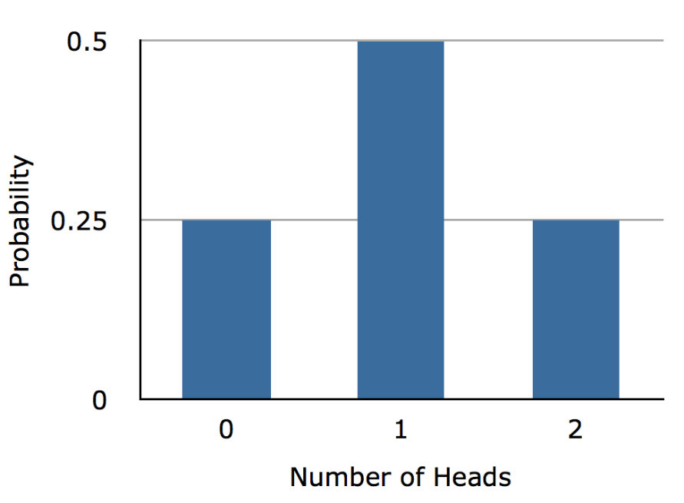
Number of Heads
Outcome | First Flip | Second Flip
1 | Heads | Heads
2 | Heads | Tails
3 | Tails | Heads
4 | Tails | Tails
Number of Heads | Probability
0 | 1/4
1 | 1/2
2 | 1/4
Notes:
The four possible outcomes can be classified in terms of the number of heads that come up. The number could be two (Outcome 1), one (Outcomes 2 and 3) or 0 (Outcome 4). The probabilities of these possibilities are shown in the lower Table and the Figure. Since one head appears in two of the outcomes, the probability of this event is equal to 1/4 + 1/4 = 1/2. The table summarizes the situation.
The Figure is a discrete probability distribution: It shows the probability for each of the values on the X-axis. Defining a head as a "success," It shows the probability of 0, 1, and 2 successes for two trials (flips) for an event that has a probability of 0.5 of being a success on each trial. This makes the figure an example of a binomial distribution.

Slide 96
Binomial Formula
N : number of trials
π : probability of success for each trial
Notes:
The binomial distribution consists of the probabilities of each of the possible numbers of successes on N trials for independent events that each have a probability pi of occurring. For the coin flip example, N = 2 and πι = 0.5. The formula for the binomial distribution is shown here. P of (x) is the probability of x successes out of N trials, N is the number of trials, and pi is the probability of success on a given trial.

Slide 97
P(one or more heads) = P(1) + P(2) = 0.75
If probably of heads is only 0.4
P(one or more heads) = P(1) + P(2) = 0.64
Notes:
Applying this to the coin flip example, we get the following probabilities for 0, 1, and 2 heads.
If you flip a coin twice, what is the probability of getting one or more heads? Since the probability of getting exactly one head is 0.50 and the probability of getting exactly two heads is 0.25, the probability of getting one or more heads is 0.50 + 0.25 = 0.75.
Now suppose that the coin is biased so that the probability of heads is only 0.4. What is the probability of getting heads at least once in two tosses? Substituting into our general formula, you should obtain the answer .64.

Slide 98
Mean and Variance
μ = Nπ
σ² = Nπ(1-π)
Notes:
Consider a coin-tossing experiment in which you tossed a coin 12 times and recorded the number of heads. If you performed this experiment over and over again, what would the mean number of heads be? On average, you would expect half the coin tosses to come up heads. Therefore the mean number of heads would be 6. In general, the mean of a binomial distribution with parameters N (the number of trials) and πι (the probability of success for each trial) is:
(μυ) = N(πι)
where μυ is the mean of the binomial distribution. The variance of the binomial distribution is:
Σιγμα σθυαρεδ = N πι(1- πι)
where σιγμα σθυαρεδ is the variance of the binomial distribution.

Slide 99
Example: 12 Coin Flips
μ = Nπ = (12)(0.5) = 6
σ² = Nπ (1-π) = (12)(0.5)(1.0 - 0.5) = 3.0
Notes:
Let's return to the coin tossing experiment. The coin was tossed 12 times so N = 12. A coin has a probability of 0.5 of coming up heads. Therefore, πι = 0.5. The mean and variance can therefore be computed as follows:
μυ = Nπ = (12)(0.5) = 6 σιγμα σθυαρεδ = Nπι(1-πι)= (12)(0.5)(1.0 - 0.5) = 3.0.
Naturally, the standard deviation is the square root of the variance.

Slide 100
Poisson Distribution
Compute probability of a particular number of “successes”
Independent Events
Notes:
The Poisson distribution can be used to calculate the probabilities of various number of "successes" based on the mean number of successes. In order to apply the Poisson distribution the various events must be independent. Keep in mind that the term "success" does not really mean success in the traditional positive sense. It just means that the outcome in question occurs.

Slide 101
Poisson Distribution
Mean weekday calls = 8
What is probability that on a given day there will be 11 calls?
Notes:
Suppose you knew that the mean number of calls to a fire station on a weekday is 8. What is the probability that on a given weekday there would be 11 calls?

Slide 102
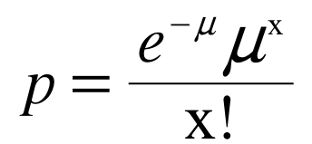
Poisson Distribution
e is base of natural logarithms
µ is the mean
x is the number of events
Notes:
The probability (p) can be computed using this formula where e is the base of natural logarithms, mu is the mean number of successes, and x is the number of successes in question.

Slide 103
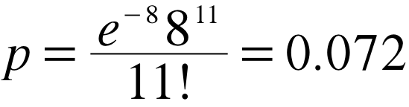
Poisson Distribution
e = 2.718
µ = 8
x =11
Notes:
For this example, the mean is 8 and the number of successes is 11. The probability of exactly 11 successes is 0.072

Slide 104
Means and SD
Mean = µ
SD = µ
Notes:
The mean of the Poisson distribution is μ. The standard deviation is also equal to μ. Thus for this example, both the mean and the standard deviation are equal to 8.

Slide 105
Multinomial Distribution
Binomial applies when there are two possible outcomes
Independent Events
Notes:
The binomial distribution allows one to compute the probability of obtaining a given number of binary outcomes. For example it can be used to compute the probability of getting 6 heads out of 10 coin flips. The flip of a coin is a binary outcome because it has only two possible outcomes: heads and tails.
The multinomial distribution can be used to compute the probabilities in situations in which there are more than two possible outcomes.

Slide 106
Chess Example
P(A wins) = 0.40
P(B wins) = 0.35
P(draw) = 0.25
In 12 games find probability
A wins 7
B wins 2
3 Draws
Notes:
For example suppose that two chess players had played numerous games and it was determined that the probability that Player A would win is 0.40, the probability that Player B would win is 0.35, and the probability that the game would end in a draw is 0.25. The multinomial distribution can be used to answer questions such as: "If these two chess players played 12 games what is the probability that Player A would win 7 games Player B would win 2 games and the remaining 3 games would be drawn?"

Slide 107
The Multinomial Distribution
Notes:
This formula gives the probability of obtaining a specific set of outcomes when there are three possible outcomes for each event. For the chess example, Outcome 1 is player A winning; Outcome 2 is Player B winning, and Outcome 3 is a draw.

Slide 108
The Multinomial Distribution
Notes:
For the chess example, n = 12 because there are 12 games, n 1 = 7 because that is the number of games for Player A to win, n 2 = 2 because that is the number of games for Player B to win, n 3 = 3 because that is the number of draws. The probabilities of these events are 0.40, 0.35, and 0.25. The probability of 7 wins for Player A, 2 wins for player B and 3 draws is 0.0248

Slide 109
Hypergeometric Distribution
Sampling without replacement
Probability both cards will be aces?
Notes:
The hypergeometric distribution is used to calculate probabilities when sampling without replacement. For example, suppose you first randomly sampled 1 cards from a deck of 52. Then, without putting the card back in the deck you sample a second and then (again without replacing cards) a third. Given this sampling procedure, what is the probability that exactly two of the sampled cards will be aces (4 of the 52 cards in the deck are aces).

Slide 110
The Hypergeometric Distribution
p is the probability of obtaining k successes
k is the number of "successes" in the population
x is the number of "successes" in the sample
N is the size of the population
n is the number sampled
_{k}C_{x} is the number of combinations of k things taken x at a time
Notes:
This is the general formula for computing probabilities using the hypergeometric distribution. p is the probability of obtaining k successes
k is the number of "successes" in the population
x is the number of "successes" in the sample
Uppercase N is the size of the population
Lowercase n is the number sampled
kCx is the number of combinations k things taken x at a time

Slide 111
The Hypergeometric Distribution
p = .013
k = 4
x = 2
N = 52
Notes:
k is the number of "successes" in the population which is 4 because there are 4 aces
x is the number of "successes" in the sample which is 2 because the question asks about the probability of obtaining 2 aces.
N is the size of the population which is 52 because there are 52 cards in a deck
n is the number sampled which is 2 because two cards are sampled without replacement
The formulas for the number of combinations of k things taken x are used to compute the probability which is equal to 0.013

Slide 112
Mean and Standard Deviation
Notes:
The formulas for the mean and standard deviation of the hypergeometric distribution are shown here.

Slide 113
Bayesian
Posterior Distributions

Slide 114
Disease X
You’ve tested positive for Disease X.
The test is known to be 95% accurate.
So, you’d think P(you have Disease X) would be 0.95.
Right?
Notes:
Suppose that at your regular physical exam you test positive for Disease X. Although Disease X has only mild symptoms, you are concerned and ask your doctor about the accuracy of the test. It turns out that the test is 95% accurate. It would appear that the probability that you have Disease X is therefore 0.95. However, the situation is not that simple.

Slide 115
Misses and False Positives
Misses: You have Disease X, but test negative
False Positives: You don’t have Disease X, but test positive.
Suppose there is a miss rate of 0.01 and a false positive rate of 0.09.
So, you’d think :
P(have Disease X | test positive) = 0.91
Right?
Notes:
For one thing, more information about the accuracy of the test is needed because there two kinds of errors the test can make: misses and false positives. If you actually had Disease X and the test failed to detect it, that would be a miss. If you did not have Disease X and the test indicated you did, that would be a false positive. The miss and false positive rates are not necessarily the same. For example, lets' say that the test accurately indicates the disease in 99% of the people who have it and accurately indicates no disease in 91% of the people who do not have it. This would mean that the test has a miss rate of 0.01 and a false positive rate of 0.09. This would lead you to revise your judgment and conclude that your chance of having the disease is 0.09 rather than 0.05. But should it?

Slide 116
Base Rates
Hit rate = 0.99
False positive rate = 0.09
Base rate = 0.02
Of 1,000,000 people:
0.02 x 1,000,000 = 20,000 have disease
0.99 x 20,000 =19,800 are hits
980,000 do not have disease
0.09 x 980,000 = 88,200 are false positives
88,200 incorrectly diagnosed with the disease
Notes:
The analysis becomes complicated if more than or fewer than half the people in your situation have Disease X. The proportion of the people who have the disease is called the base rate.
Assume that Disease X is a rare disease, and only 2% of people in your situation have it. How does that affect the probability that you have it? Or, more generally, what is the probability that someone who tests positive actually has the disease.
Lets consider what would happen if one million people were tested. Out of these one million people, 2% or 20,000 people would have the disease. Of these 20,000 with the disease, the test would accurately detect it in 99% of them. This means that 19,800 cases would be accurately identified. Now lets consider the 98% of the one million people (980,000) who do not have the disease. Since the false positive rate is 0.09, 9% of these 980,000 people will test positive for the disease. This is a total of 88,200 people incorrectly diagnosed.

Slide 117
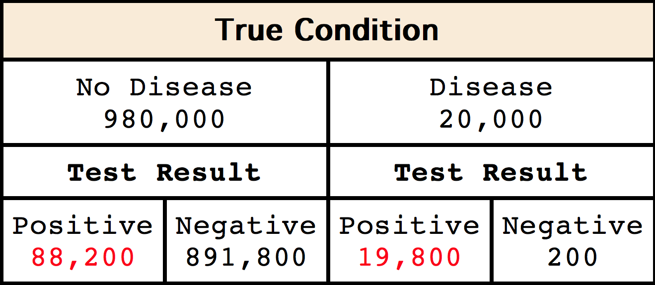
The Summary
Probability you have the disease given that you test positive is only 19,800/(19,800 + 88,200) = 0.1833!
Notes:
These results are summarized in the Table. The numbers of people diagnosed with the disease are shown in red. Of the one million people tested, the test was correct for 891,000 of those without the disease and for 19,800 with the disease; the test was correct 91% of the time. However, if you look only at the people testing positive (shown in red), only 19,800 (0.1833) of the 911,600 testing positive actually have the disease.
To sum up, 19,800 people who tested positive would actually have the disease and 88,200 people who tested positive would not have the disease. This means that of all those who tested positive, only
19,800/(19,800 + 88,200) = 0.1833 would actually have the disease. So the probability that you have the disease is not 0.95, or 0.91, but only 0.1833.

Slide 118
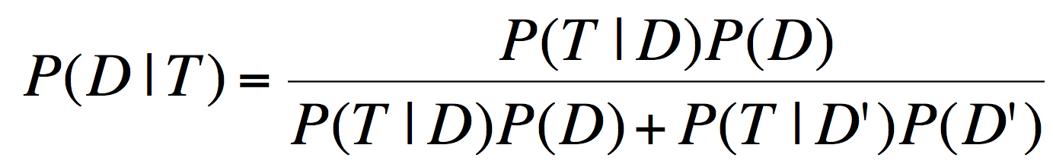
Bayes’s Theorem
D: the event that you have disease X
T: the event that you test positive for disease X
P(D) = prior probability
P(D|T) = posterior probability
Notes:
This same result can be obtained using Bayes' theorem. Bayes' theorem considers both the prior probability of an event and the diagnostic value of a test to determine the posterior probability of the event. For the current example, the event is that you have Disease X. Let's call this Event D. Since only 2% of people in your situation have Disease X, the prior probability of Event D is 0.02. Or, more formally, P(D) = 0.02. If D' represents the probability that Event D is false, then P(D') = 1 - P(D) = 0.98.
To determine the diagnostic value of the test, we need to define another event: testing positive for Disease X. Let's call this event T. The diagnostic value of the test depends on the probability you will test positive given that you actually have the disease, written as P(T|D), and the probability you test positive given that you do not have the disease, is written as P(T|D'). Bayes' theorem shown here allows you to calculate P(D|T), the probability that you have the disease given that you test positive for it.
In a moment you will see how to use Bayes’s Theorem to arrive at the same answer as determined previously.

Slide 119
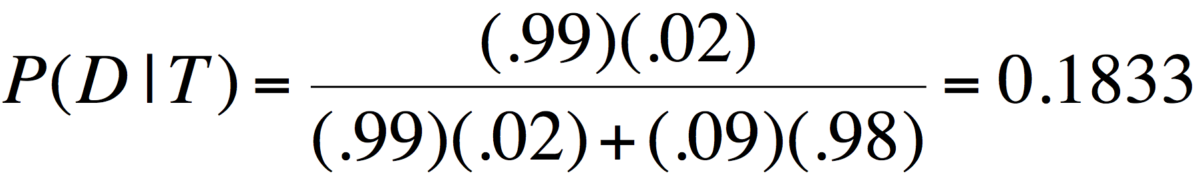
Our Example
P(T|D) = | 0.99
P(T|D’) = | 0.09
P(D) = | 0.02
P(D’) = | 0.98
Notes:
As you can see, the probability that you have the disease given that you tested positive is 0.1833, the same as computed previously.

Slide 120
Normal Distribution

Slide 121
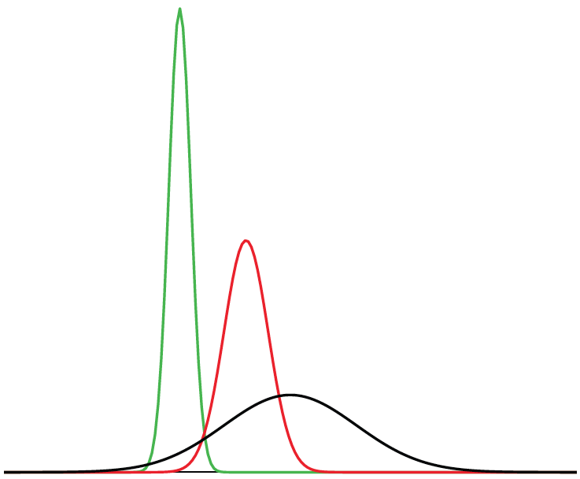
Naming the Normal Distribution
=
=
Gaussian Curve
Normal Curve = Bell Curve = Gaussian Curve
Notes:
The normal distribution is also called the “Gaussian curve” after the mathematician Karl-Friedrich Gauss.

Slide 122
Normal Distributions
All three distributions are symmetric
All have relatively more values at the center of the distribution and relatively few in the tails
Notes:
All three distributions are symmetric with relatively more values at the center of the distribution and relatively few in the tails.

Slide 123
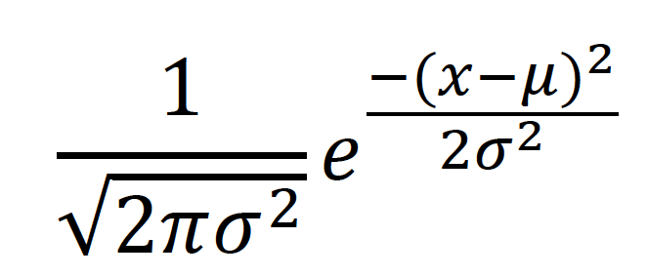
Formula for the Density of the Normal Distribution
μ is the mean
σ is the standard deviation
e is the base of the natural logarithm
π is the constant pi
Notes:
The parameters μ and σ are the mean and standard deviation respectively and define the normal distribution. The symbol e is the base of the natural logarithm and pi is a constant.

Slide 124
Normal Distribution
History

Slide 125

History of the Normal Distribution
Binomial distribution
Useful to answer questions like If a fair coin is flipped 100 times, what is the probability of getting 60 or more heads?
Notes:
In the chapter on probability, we saw that the binomial distribution could be used to solve problems such as "If a fair coin is flipped 100 times, what is the probability of getting 60 or more heads?"

Slide 126
Probability with Binomial Distribution
Notes:
The formula presented here is the one you would use to determine the probability of obtaining exactly x heads out of N flips, where x is the number of heads, N is the number of flips, and pi is the probability of a head. In our problem, x is 60, N equals 100 and pi equals 0.5. Therefore, to find the probability of 60 or more heads, you compute the probability of 60 heads, then the probability of 61 heads, 62 heads, etc, and add up all these probabilities.

Slide 127
Probability with Binomial Distribution
Whew!
Notes:
Imagine long it must have taken to compute binomial probabilities before the advent of calculators and computers.

Slide 128
Important to Gamblers
Abraham de Moivre
Consultant to gamblers
Noticed that as the number of events increased, the distribution approached a smooth curve.
Notes:
Abraham de Moivre, an 18th century statistician and consultant to gamblers was often called upon to make these lengthy computations. de Moivre noted that when the number of events, or coin flips, increased, the shape of the binomial distribution approached a very smooth curve.

Slide 129
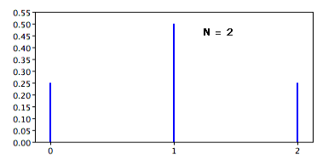
Binomial Distribution
Notes:
Here is the binomial distribution for 2 events.

Slide 130
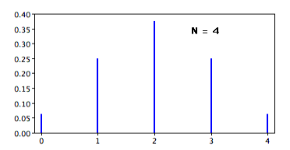
Binomial Distribution
Notes:
For four events…

Slide 131
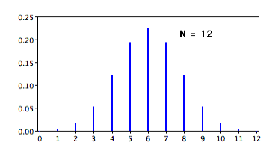
Binomial Distribution
Notes:
And for twelve events… Notice how the distribution begins to form a smooth curve as the number of events increases.

Slide 132
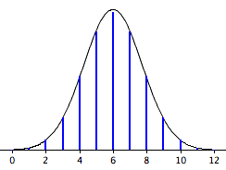
Discovery of the Normal Curve
Notes:
de Moivre reasoned that if he could find a mathematical expression for this curve, he would be able to solve problems such as finding the probability of 60 or more heads out of 100 coin flips much more easily. He accomplished this in 1733 and the curve he discovered is now called the "normal curve."

Slide 133
Importance of the Normal Curve
Many natural phenomena are approximately normal
Astronomical observations
Mathematics
Notes:
The importance of the normal curve stems primarily from the fact that the distribution of many natural phenomena are at least approximately normally distributed.
One of the first applications of the normal distribution was to the analysis of errors of measurement made in astronomical observations, errors that occurred because of imperfect instruments and imperfect observers. Galileo in the 17th century noted that these errors were symmetric and that small errors occurred more frequently than large errors. This led to several hypothesized distributions of errors, but it was not until the early 19th century that it was discovered that these errors followed a normal distribution.
Independently the mathematicians Adrian in 1808 and Gauss in 1809 developed the formula for the normal distribution and showed that errors were fit well by this distribution.

Slide 134
Central Limit Theorem
Laplace discovered the same distribution in 1778.
Derived the “Central Limit Theorem”
Distribution of means is approximately normal
Notes:
This same distribution had been discovered by Laplace in 1778 when he derived the extremely important central limit theorem. The central limit theorem is covered in detail in another section but simply put, Laplace showed that even if a distribution is not normally distributed, the means of repeated samples from the distribution would be very nearly normal, and that the the larger the sample size, the closer the distribution would be to a normal distribution.
Most statistical procedures for testing differences between means assume normal distributions. Because the distribution of means is very close to normal, these tests work well even if the distribution itself is only roughly normal.

Slide 135
Application to Humans
Quételet was the first to apply the normal distribution to human characteristics
Noted that characteristics such as height, weight, and strength were normally distributed
Notes:
Quételet was the first to apply the normal distribution to human characteristics. He
noted that characteristics such as height, weight, and strength were approximately normally distributed.

Slide 136
Area of the
Normal Distribution

Slide 137
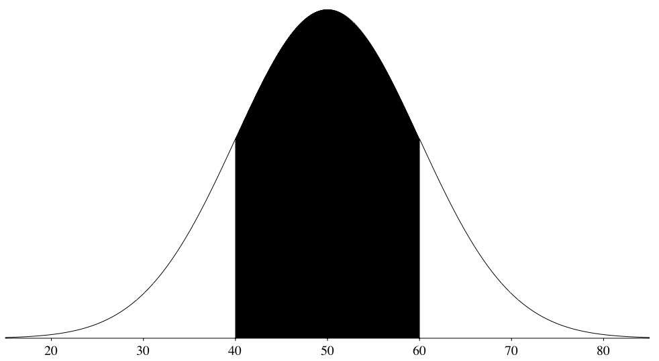
Areas Under Normal Distributions
The normal distribution shown here has a mean of 50 and a standard deviation of 10.
Notes:
This figure shows a normal distribution with a mean of 50 and a standard deviation of 10. The shaded area is the area from one standard deviation below the mean (50-10 = 40) to one standard deviation above the mean (50 + 10 = 60).

Slide 138
One Standard Deviation from the Mean
The shaded area between 40 and 60 contains 68% of the distribution
Notes:
The shaded area between 40 and 60 contains 68% of the distribution. The area within one standard deviation of the mean is 0.68.

Slide 139
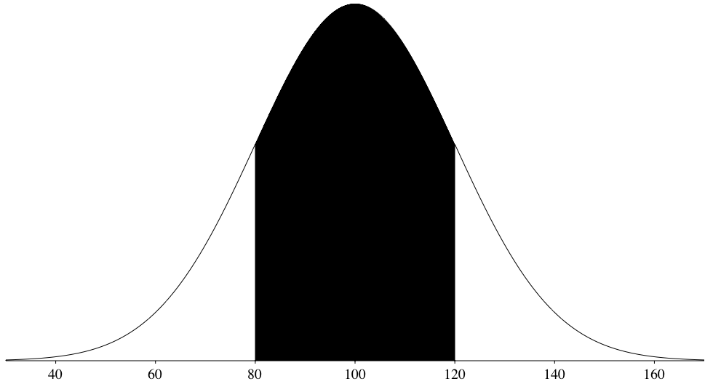
Normal Distribution with a Mean of 100 an SD of 20
Notes:
Here you see a normal distribution with a mean of 100 and a standard deviation of 20.

Slide 140
One Standard Deviation from the Mean
68% of the area
Notes:
Again 68% of the distribution is within one standard deviation of the mean.

Slide 141
One Standard Deviation from the Mean
68% of the area of any normal distribution is within one standard deviation of the mean.
Notes:
The two normal distributions you just saw are specific examples of the general rule that 68% of the area of any normal distribution is within one standard deviation of the mean.

Slide 142
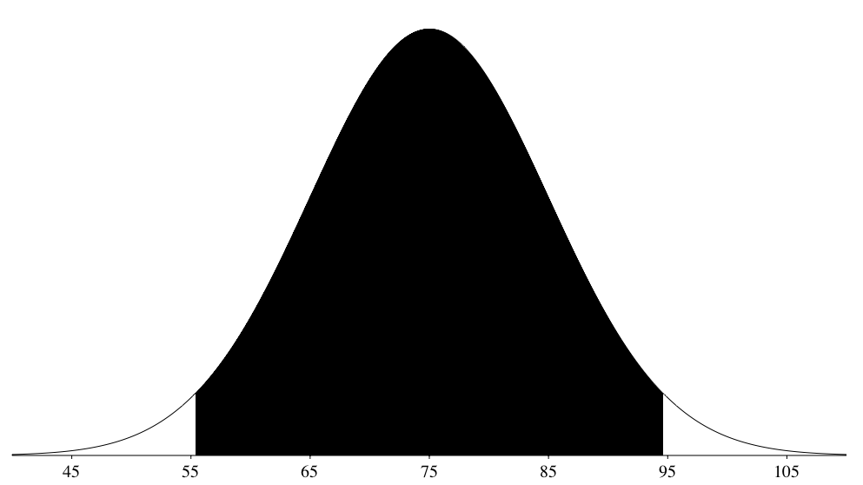
1.96 Standard Deviations from the Mean
Notes:
For all normal distributions, 95% of the area is within 1.96 standard deviations of the mean

Slide 143
1.96 Standard Deviations from the Mean
Notes:
The shaded area contains 95% of the area and extends from 55.4 to 94.6.

Slide 144
Two Standard Deviations from the Mean
For normal distributions 95% of the area is within 1.96 standard deviations of the mean
For an approximation 2 can be used
Notes:
For all normal distributions, 95% of the area is within 1.96 standard deviations of the mean. For quick approximations, it is sometimes useful to round off and use 2 rather than 1.96.

Slide 145
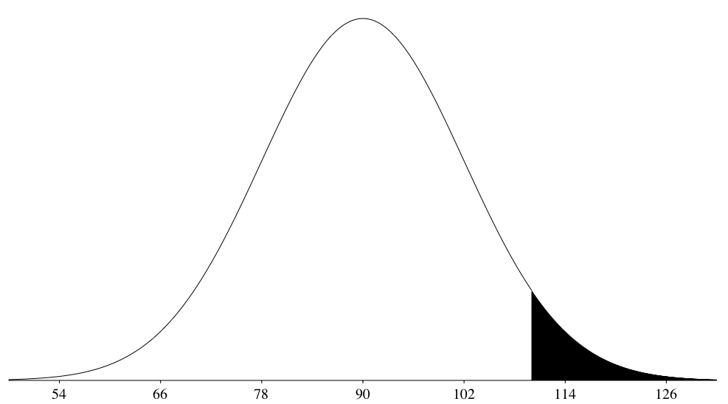
Area = 0.04779
Notes:
The calculator “Calculate Area for a given X” can be used to calculate areas under the normal distribution. Here it is used to calculate the are above 110 for a normal distribution with a mean of 90 and a standard deviation of 12. The area is shown in the figure and numerically at the bottom of the screen. The area is 0.047790.

Slide 146
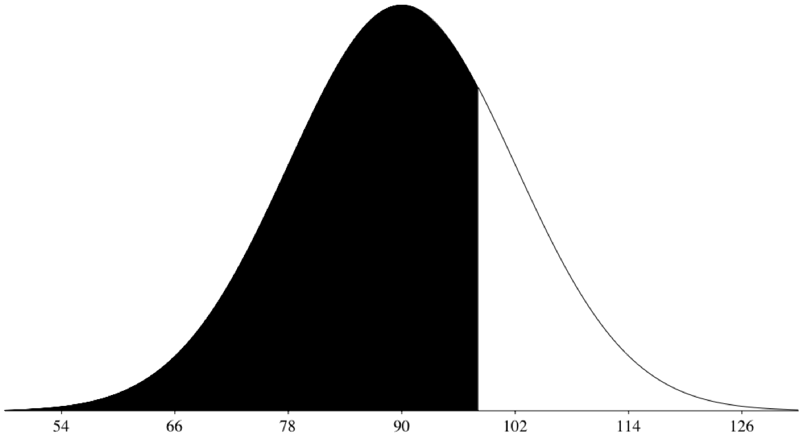
98.09
Notes:
The calculator “Calculate X for a given Area” works in reverse. For example, say you wanted to find the score corresponding to the 75th percentile of a normal distribution with mean of 90 and a standard deviation of 12. You enter 90 for the mean and 12 for the standard deviation. Then enter 0.75 for the shaded area and click the “Below” button. The area below 98.0939 is 0.75

Slide 147
Standard
Normal Distribution

Slide 148
Standard Normal Distribution
A normal distribution with a mean of 0 and a standard deviation of 1 is called a standard normal distribution
Notes:
A normal distribution with a mean of 0 and a standard deviation of 1 is called a standard normal distribution.

Slide 149
Standard Normal Distribution
Z | Area below Z
-2.50 | 0.0062
-2.49 | 0.0064
-2.48 | 0.0066
-2.47 | 0.0068
-2.46 | 0.0069
-2.45 | 0.0071
-2.44 | 0.0073
-2.43 | 0.0075
-2.42 | 0.0078
-2.41 | 0.0080
-2.40 | 0.0082
-2.39 | 0.0084
-2.38 | 0.0087
-2.37 | 0.0089
-2.36 | 0.0091
-2.35 | 0.0094
-2.34 | 0.0096
-2.33 | 0.0099
-2.32 | 0.0102
Areas of the normal distribution are often represented by tables of the standard normal distribution.
Notes:
Areas of the normal distribution are often represented by tables of the standard normal distribution. A portion of a table of the standard normal distribution is shown here.

Slide 150
Standard Normal Distribution
Z | Area below Z
-2.50 | 0.0062
-2.49 | 0.0064
-2.48 | 0.0066
-2.47 | 0.0068
-2.46 | 0.0069
-2.45 | 0.0071
-2.44 | 0.0073
-2.43 | 0.0075
-2.42 | 0.0078
-2.41 | 0.0080
-2.40 | 0.0082
-2.39 | 0.0084
-2.38 | 0.0087
-2.37 | 0.0089
-2.36 | 0.0091
-2.35 | 0.0094
-2.34 | 0.0096
-2.33 | 0.0099
-2.32 | 0.0102
The column “Z” contains values of the standard normal distribution
The second column contains the area below Z
Notes:
The first column titled “Z” contains values of the standard normal distribution; the second column contains the area below Z.

Slide 151
Standard Normal Distribution
Z | Area below Z
-2.50 | 0.0062
-2.49 | 0.0064
-2.48 | 0.0066
-2.47 | 0.0068
-2.46 | 0.0069
-2.45 | 0.0071
-2.44 | 0.0073
-2.43 | 0.0075
-2.42 | 0.0078
-2.41 | 0.0080
-2.40 | 0.0082
-2.39 | 0.0084
-2.38 | 0.0087
-2.37 | 0.0089
-2.36 | 0.0091
-2.35 | 0.0094
-2.34 | 0.0096
-2.33 | 0.0099
-2.32 | 0.0102
The Z column is equal to the number of standard deviations below (or above) the mean
A Z of -2.5 represents a value 2.5 standard deviations below the mean
Notes:
Since the distribution has a mean of 0 and a standard deviation of 1 the Z column is equal to the number of standard deviations below (or above) the mean. For example, a Z of -2.5 represents a value 2.5 standard deviations below the mean. The area below Z is 0.0062. This means that 0.0062 of the distribution is below -2.5.

Slide 152
Transforming to a Standard Normal Distribution
A value from any normal distribution can be transformed into its corresponding value on a standard normal distribution using this formula:
Z = (X-μ)/σ
Notes:
A value from any normal distribution can be transformed into its corresponding value on a standard normal distribution using this formula.

Slide 153
Transforming to a Standard Normal Distribution
Z = (X-μ)/σ
Z is the value on the standard normal distribution
X is the value on the original distribution
μ is the mean of the original distribution
σ is the standard deviation of the original distribution
Notes:
In this formula, Z is the value on the standard normal distribution, X is the value on the original distribution, μυ is the mean of the original distribution and sigma is the standard deviation of the original distribution.

Slide 154
An Example
What portion of a normal distribution with a mean of 50 and a standard deviation of 10 is below 26?
Z = (X-μ)/σ = (26 – 50)/10 = -2.4
Notes:
As a simple application, what portion of a normal distribution with a mean of 50 and a standard deviation of 10 is below 26? First we transform the score of 26 to a score on the standard normal distribution (a Z score). The result is -2.4.

Slide 155
An Example
Z | Area below Z
-2.50 | 0.0062
-2.49 | 0.0064
-2.48 | 0.0066
-2.47 | 0.0068
-2.46 | 0.0069
-2.45 | 0.0071
-2.44 | 0.0073
-2.43 | 0.0075
-2.42 | 0.0078
-2.41 | 0.0080
-2.40 | 0.0082
-2.39 | 0.0084
-2.38 | 0.0087
-2.37 | 0.0089
-2.36 | 0.0091
-2.35 | 0.0094
-2.34 | 0.0096
-2.33 | 0.0099
-2.32 | 0.0102
From the table we can see that 0.0082 of the distribution is below -2.4.
Notes:
From the table, we can see that 0.0082 of the distribution is below -2.4.

Slide 156
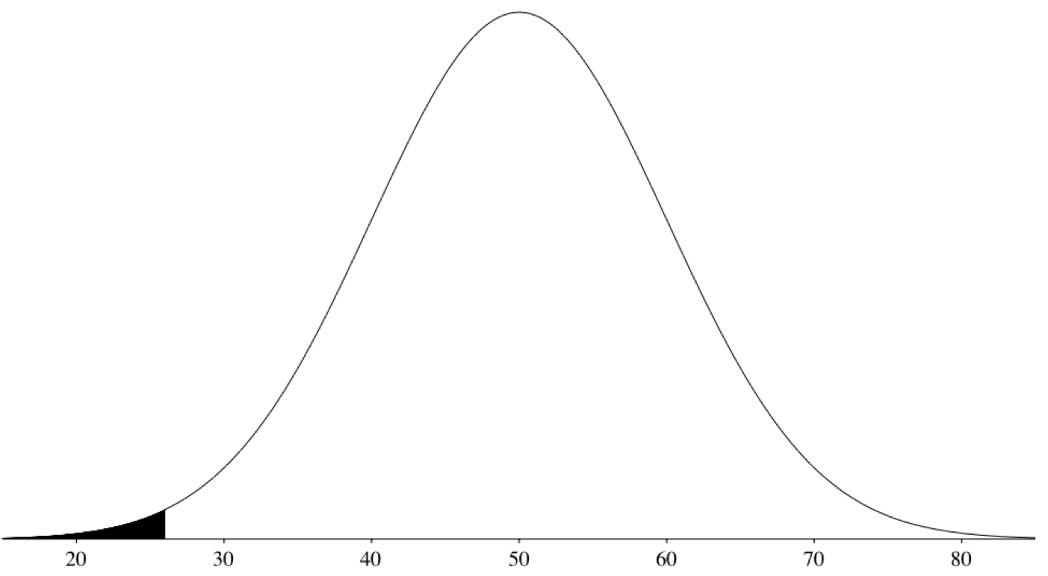
Standard Normal Distribution
Notes:
There is no need to transform to Z if you use the calculator as shown here.

Slide 157
Standard Normal Distribution
If all values transformed to Z scores, then the distribution will have a mean of 0 and a standard distribution
This process is called standardizing the distribution
Notes:
If all the values in a distribution are transformed to Z scores, then the distribution will have a mean of 0 and a standard distribution. This process of transforming the distribution to one with a mean of 0 and a standard deviation of 1 is called standardizing the distribution.

Slide 158
Normal Approximation to Binomial

Slide 159
Mean and Variance of the Binomial Distribution
The binomial distribution has:
μ = Nπ = (10)(0.5) = 5
σ² = Nπ (1-π)
= (10)(0.5)(0.5) = 2.5
The standard deviation is 1.5811
Notes:
The binomial distribution has a mean of Nπ. Since there are 10 coin flips, N = 10. The probability of a head on any given flip is .5, so π = .5 The mean is therefore (10)(0.5) = 5. The variance is Nπ (1-π) = (10)(0.5)(0.5) = 2.5. The standard deviation is 1.5811.

Slide 160
Normal Approximation to the Binomial
How many standard deviations above the mean is 8 heads?
(8-5)/1.5811 = 1.8973
It is 1.8973 standard deviations above the mean
Notes:
Recall that the distribution has a mean of 5 and a standard deviation of 1.5811. A total of 8 heads is (8-5)/1.5811 = 1.8973 standard deviations above the mean of the distribution.

Slide 161
The Probability of a Point
What is the probability of getting a value exactly 1.8973 standard deviations above the mean?
The probability is 0!
Notes:
The question then is, “What is the probability of getting a value exactly 1.8973 standard deviations above the mean?” You may be surprised to learn that the answer is 0.

Slide 162
Continuous versus Discrete
The probability of any one specific point is 0.
The binomial distribution is a discrete probability distribution.
The normal distribution is a continuous distribution.
Notes:
The probability of any one specific point is 0. The problem is that the binomial distribution is a discrete probability distribution whereas the normal distribution is a continuous distribution.

Slide 163
Continuous versus Discrete
Round off and consider any value from 7.5 to 8.5 to represent an outcome of 8 heads
Then figure out the area under a normal curve from 7.5 to 8.5
Notes:
The solution is to round off and consider any value from 7.5 to 8.5 to represent an outcome of 8 heads. Using this approach, we figure out the area under a normal curve from 7.5 to 8.5.

Slide 164
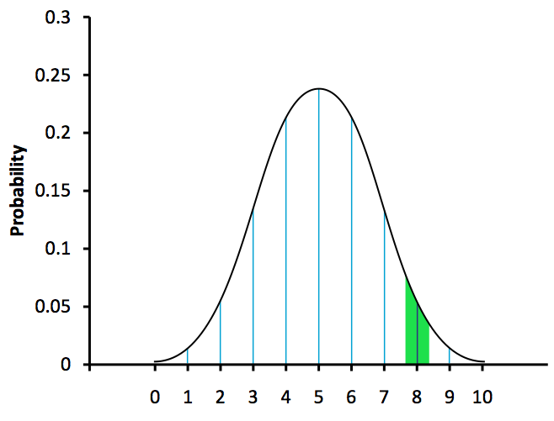
Area from 7.5 to 8.5
Notes:
The shaded area is an approximation of the probability of obtaining 8 heads.

Slide 165
Calculating the Probability
Find a Z score for 7.5 using the formula Z = (7.5-5)/1.5811 = 1.58
Find the area below a Z of 1.58 = 0.943
Find a Z score for 8.5 using the formula Z = (8.5 – 5)/1.5811 = 2.21
Find the area below a Z of 2.21 = 0.987
Subtract the value in step 2 from the value in step 4 to get 0.044. This is the approximation
Notes:
To find the probability, you first find the area below 7.5. The Z for 7.5 is computed by subtracting the mean of 5 from 7.5 and dividing by the standard deviation of 1.5811. This gives a Z of 1.58. A Z table (or the normal calculator) shows that the proportion of a normal distribution below 1.58 is 0.943. The area below 8.5 is calculated in a similar way and is equal to 0.987. The area between 7.5 and 8.5 can be found by subtraction: .987 - .943 =0.044. So, the probability of getting exactly 8 heads out of 10 flips is 0.044

Slide 166
Other Problems
Use the same logic to calculate the probability of a range of outcomes
To calculate the probability of 8 to 10 flips, calculate the area from 8.5 to 10.5
Notes:
The same logic applies when calculating the probability of a range of outcomes. For example, to calculate the probability of 8 to 10 flips, calculate the area from 8.5 to 10.5.

Slide 167
Sampling Distributions

Slide 168
A Statistician’s Question
Consider a sample of 10 Houston women.
Would the mean weight of your sample equal the mean weight in the population?
Notes:
A critical question in inferential statistics is determining the degree to which sample statistics vary from each other and from the population parameter. Consider whether the mean weight from a sample of 10 Houston women would equal the mean weight of all women in Houston.? Think about how you would answer this question.
You would not expect your sample mean to be exactly equal to the mean of all women in Houston. It might be somewhat lower or somewhat higher, but not exactly the same

Slide 169
Sampling Distributions
Determine how different a sample statistic is likely to be from a population parameter.
Notes:
Because inferential statistics concern generalizing from a sample to a population, it is critical to determine how far sample statistics vary from each other and population parameters. These determinations are made based on sampling distributions.

Slide 170
Let’s Play Pool!
Take three pool balls
Select two randomly
Find the mean
1
2
3
Notes:
To illustrate the concept of a sampling distributions we will use a simple example. Select two of these three pool balls randomly and find the average of their numbers.

Slide 171
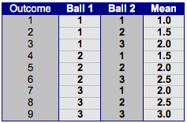
Possible Outcomes
Notes:
When you consider all possible outcomes from this scenario, you will find that all the means are either 1.0, 1.5, 2.0, 2.5, or 3.0. Notice that some means occur more frequently than others. For example, there are three ways to get a mean of 2 but only one way to get a mean of three.

Slide 172

Frequencies
Notes:
The frequencies and relative frequencits of each possible mean are reported in this table. Because there are nine possible outcomes, the relative frequencies are equal to the frequencies divided by nine.

Slide 173
Relative Frequency Distribution
Notes:
This graph illustrates the distribution of the relative frequencies. Since the Y-axis is the probability of obtaining a given mean from a sample of two balls, the distribution can also be considered a probability distribution.
This distribution is called the sampling distribution of the mean. More specifically, it is the sampling distribution of the mean for a sample size of two. In this example, the distribution of pool balls and the sampling distribution are both discrete distributions. In other words, the pool balls can only be 1, 2, or 3, and the sample mean is necessarily one of a five values.

Slide 174
Furthermore...
Take two pool balls from one sample and find the mean.
Repeat for thousands of other samples.
As the number of samples approaches infinity, the frequency distribution will approach the sampling distribution.
2
Notes:
There is an alternative way of conceptualizing a sampling distribution that will be useful for more complex distributions. This time, we’re going to use multiple samples. Imagine that two balls are sampled (with replacement) and the mean of the two balls is computed. This process is repeated for thousands of other samples. A relative frequency distribution is drawn for the entire set of means. The more samples, the closer the relative frequency distribution will come to the sampling distribution.
In other words, you can conceive of a sampling distribution as being a frequency distribution based on a very large number of samples.

Slide 175
Therefore...
The sampling distribution equals the frequency distribution exactly when there is an infinite number of samples.
Notes:
To be strictly correct, the sampling distribution only equals the frequency distribution exactly when there is an infinite number of samples.

Slide 176
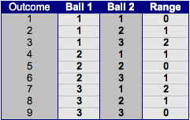
Sampling Distribution of the Range
Notes:
It is important to keep in mind that every statistic, not just the mean, has a sampling distribution. This table shows all the possible outcomes for the range of two numbers.

Slide 177

Frequencies
Notes:
This table lists the frequencies of each range.

Slide 178
Relative Frequency Distribution
Notes:
This graph illustrates the sampling distribution of the range for this discrete distribution.

Slide 179
Sample Size
Sampling distributions vary depending on sample sizes.
Previous examples used N = 2.
Next example uses N = 3.
Notes:
It is also important to keep in mind that there is a sampling distribution for various sample sizes. For simplicity, we have been using a sample size of two.

Slide 180
Relative Frequency Distribution
Notes:
This graph illustrates the sampling distribution of the range for a sample size of three

Slide 181
Continuous Distributions
Consider a continuous population.
1,000 pool balls.
Range from .001 to 1.00
Sample two balls and compute the mean.
Repeat millions of times.
Notes:
Now it is time to move beyond our discrete set of three pool balls.
Instead of using three, let’s use 1,000 pool balls with numbers ranging from .001 and 1.00 in equal steps. Though this is not actually continuous, it is close enough for practical purposes. As before, we are interested in the distribution of means that we would get if we sampled two balls and computed the means.
In the previous examples, we started by computing the mean for each of the nine possible outcomes. In this case, we would have 1,000,000 possible outcomes… sounds like it would be very tedious.
Instead, we can use our second conceptualization of sampling distributions. Specifically, we use the relative frequency distribution that would occur if samples of two balls were repeatedly taken and the mean of each sample computed.

Slide 182
Sampling Distributions and Inferential Statistics
The examples specified a population
sampling distributions were determined from this population
In practice, the process is the other way around
Estimate parameters of sampling distribution from sample data
Notes:
As we stated at the beginning of this section, sampling distributions are important for inferential statistics. In the examples give so far, a population was specified and the sampling distribution of the mean and range were determined. In practice, the process proceeds the other way. You collect sample data and, from these data, you estimate parameters for the sampling distribution. This knowledge can be very useful.

Slide 183
Uses of the Sampling Distribution
How close is a sample mean to a population mean?
How close are means from different samples?
Notes:
For example, knowing the degree to which sample means differ from each other and from the population mean gives you a sense of how close your particular sample mean is likely to be to the population mean. Fortunately, this information is directly available from the sampling distribution.

Slide 184
Standard Error of the Mean
If sample means are about the same then the standard error of the mean is small.
If sample means vary greatly then the standard error of the mean is large.
Notes:
The most common measure of how much sample means differ from each other is the standard error of the mean. The standard error of the mean is the standard deviation of the sampling distribution of the mean. If all the sample means were very close to the population mean (and to each other), then the standard error of the mean would be small. On the other hand, if the sample means varied considerably, then the standard error of the mean would be large.

Slide 185
Specific Example
Assume sample mean = 125
Estimate that the standard error of the mean = 5
The sample mean is likely within 10 units of the population mean.
From 115 to 135.
Notes:
To be specific, assume that your sample mean is 125, and that you estimate your standard error to be 5 (using methods to be described in a later section). If you have a normal distribution, then you could be pretty sure that your population mean is between 115 and 135, since most of a normal distribution is within two standard deviations of the mean.

Slide 186
Remember...
Sampling distributions reveal how much sample statistics vary from population parameters.
Notes:
To review, there are three primary ideas to remember from this section. First, sampling distributions help determine how sample statistics vary from population parameters and other sample statistics.

Slide 187
Remember...
As the number of samples approaches infinity, the relative frequency distribution approaches the sampling distribution.
Notes:
Second, as the number of samples approaches infinity, the relative frequency distribution approaches the sampling distribution.

Slide 188
Remember...
All statistics have sampling distributions, not just the mean.
Notes:
And last, keep in mind that all statistics have sampling distributions, not just the mean. In later sections, we will be discussing the sampling distribution of the difference between means, and the sampling distribution of Pearson’s correlation, among others.
We hope that you now have a sense of the concept of a sampling distribution and its potential uses.

Slide 189
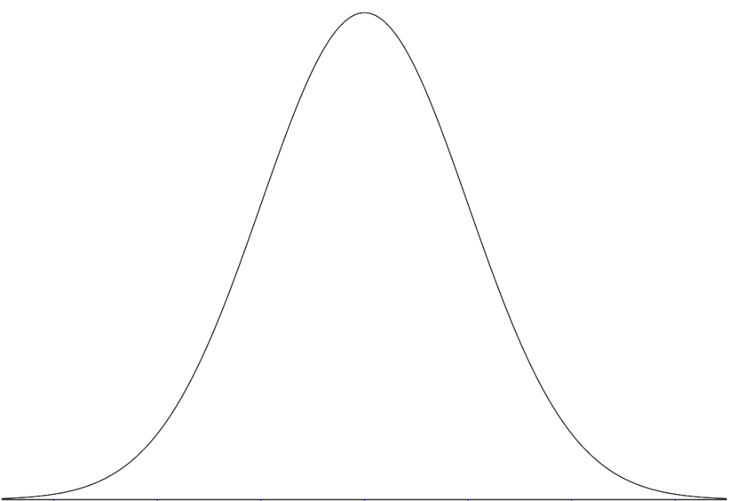
Sampling Distribution of the Mean
The sampling distribution of the mean has several important properties
μ_{M} = μ
Notes:
This section will discuss some important properties of the sampling distribution of the mean. You can think of the sampling distribution of the mean as the distribution you would get if you repeatedly sampled N numbers from a distribution, computed the mean of the N numbers, and then plotted the result as a relative frequency distribution.

Slide 190
Mean of the Sampling Distribution of the Mean
Equal to the mean of the population from which the scores were sampled (μ).
Notes:
One important property of many distributions is the mean. The mean of the sampling distribution of the mean is the mean of the population from which the scores were sampled. Therefore, if a population has a mean of 5, the mean of the sampling distribution of the mean is also 5.

Slide 191
Mean of the Sampling Distribution of the Mean
μ_{M}
Notes:
The symbol mu sub M is used to refer to the mean of the sampling distribution of the mean.

Slide 192
Mean of the Sampling Distribution of the Mean
μ_{M}
μ_{M} = μ
Notes:
Therefore, the formula for the mean of the sampling distribution of the mean can be written as mu sub M equals mu.

Slide 193
Variance of the Sampling Distribution of the Mean
Notes:
The variance of the sampling distribution of the mean is the population variance is divided by the sample size. The sample size is the number of scores used to compute the mean.

Slide 194
Variance of the Sampling Distribution of the Mean
Notes:
The formula at the bottom, is the formula for variance of the sampling distribution of the mean translated into symbols. The variance of the sampling distribution of the mean is represented with the symbol sigma squared sub M. The variance of the population is represented by the symbol sigma squared, and the sample size (the number or scores used to compute a mean) is represented by the capital letter N.

Slide 195
Effect of Sample Size
Notes:
As you look at the formula, notice that as the sample size gets larger, the variance of the sampling distribution gets smaller.

Slide 196
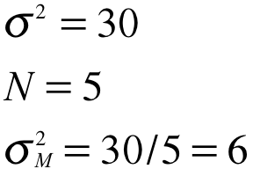
Effect of Sample Size
Notes:
For example, if the variance of the population were 30 and the sample size were 5 then the variance of the sampling distribution of the mean would be 6.

Slide 197
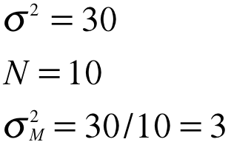
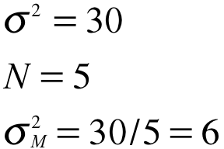
Effect of Sample Size
Notes:
Now we see a comparison of a sample size of 5 with a sample size of 10. In both cases, the population variance is 30. For the sample size of 5, the variance of the sampling distribution of the mean is 6 whereas for N = 10, the variance is 3. Notice that doubling the sample size cut the variance of the sampling distribution of the mean in half.

Slide 198
Standard Error
Notes:
The standard error of the mean is the standard deviation of the sampling distribution of the mean. Therefore the square root of the variance of the sampling distribution of the mean and can be written as shown here:
The symbol on the left represents the standard error of the mean. It has a sigma because it is a standard deviation. The subscript M indicates that the standard error in question is the standard error of the mean. The numerator of the right side of the equation contains the population standard deviation. The denominator is the square root of the sample size.

Slide 199

Central Limit Theorem
Given a population of any distribution with mean μ and variance σ².
The sampling distribution of the mean approaches a normal distribution with mean μ and variance .
Notes:
The central limit theorem states that:
Given a population with a mean mu and a variance sigma squared , the sampling distribution of the mean approaches a normal distribution with a mean of mu and a variance of sigma squared over N - as N, the sample size increases. Remember that the sample size is the number of scores that a mean is based upon.
What is remarkable about this theorem is that regardless of the shape of the parent population, the sampling distribution of the mean approaches a normal distribution.

Slide 200
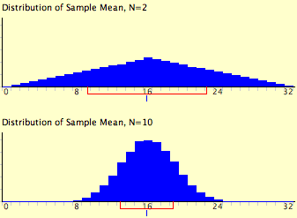
Notes:
Here is an example from the "Central Limit Theorem Demo," You may have already seen this for yourself. This figure shows the results of the simulation for N = 2 and N = 10. The parent population was a uniform distribution.
You can see that the distribution for N = 2 is far from a normal distribution. Nonetheless, it does show that the scores are denser in the middle than in the tails. For N = 10 the distribution is quite close to a normal distribution. Notice that the means of the two distributions are the same, but that the spread of the distribution for N = 10 is smaller.

Slide 201
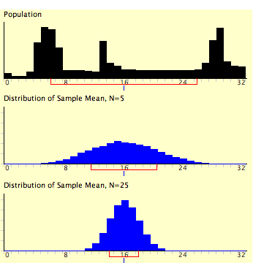
Notes:
This figure shows how closely the sampling distribution of the mean approximates a normal distribution even when the parent population is very non-normal. The distribution at the top is the parent distribution and the two figures below are the estimates of the sampling distribution for N = 5 and N = 10. The distribution of means for N = 5 was created by repeatedly sampling 5 scores from the top population and computing the mean for each sample of 5. The figure is a plot of these means.
The distribution of means for N = 25 was created the same way except that the sample size was 25 instead of 5
If you look closely you can see that the sampling distributions do have a slight positive skew. Nevertheless, the distributions are much closer to a normal distribution than is the parent population (the one at the top).

Slide 202
Difference of Means
Differences between means are often of interest
Inferential statistics are based on the sampling distribution of the difference between means
Notes:
Statistical analyses are very often concerned with the difference between means. A typical example is an experiment designed to compare the mean of a control group with the mean of an experimental group. Inferential statistics used in the analysis of this type of experiment are based on the sampling distribution of the difference between means.

Slide 203
What is this Sampling Distribution?
Repeat the following steps over and over
1. Sample n₁ scores from Population 1 and n₂ scores from Population 2.
2. Compute the means of the two samples (M₁ and M₂).
3. Compute the difference in means (M₁- M₂)
The distribution of (M₁-M₂) is the sampling distribution of the difference between means.
Notes:
The sampling distribution of the difference between means can be thought of as the distribution that would result if we repeated the following three steps over and over again:
sample n1 scores from Population 1 and n2 scores from Population 2,
compute the means of the two samples (M1 and M2),
compute the difference between means M1 - M2.
The distribution of the differences between means is the sampling distribution of the difference between means.

Slide 204
Mean of the Distribution
Mean test score for 12-year-olds is 34, Mean test score for 10-year-olds is 25.
So mean of difference between sample means would be 34 – 25 = 9
Notes:
As you might expect, the mean of the sampling distribution of the difference between means is the difference between population means. The symbol mu with the subscript m1-m2 represents the mean of the sampling distribution of the difference between mean. The right side of the equation: mu 1 - mu 2 represents the difference between population means.
For example, say that mean test score of all 12-year olds in a population were 34 and the mean test score of all 10-year olds were 25. If numerous samples were taken from each age group and the mean difference computed each time, the mean of these differences between sample means would be 34 - 25 - 9.

Slide 205

Variance of the Distribution
The variance of (M₁- M₂) is the sum of the variances of the two sampling distributions.
Notes:
From the variance sum law, we know that the variance of the sampling distribution of the difference between means is equal to the variance of the sampling distribution of the mean for Population 1 plus the variance of the sampling distribution of the mean for Population 2.

Slide 206

Variance
Notes:
Recall that the formula for the variance of the sampling distribution of the mean is the variance divided by the sample size.

Slide 207

Variance
Notes:
Since we have two populations and two samples sizes, we need to distinguish between the two variances and sample sizes.
We do this using the subscripts 1 and 2. Using this convention we can write the formula for the variance of the sampling distribution of the difference between means as shown in the lowest formula.

Slide 208
Standard Deviation
Notes:
Recall that the standard deviation is the square root of the variance. We therefore can compute the standard deviation of the sampling distribution of the difference between means by taking…

Slide 209

Standard Deviation
Notes:
…the square root. Remember - the standard deviation of a sampling distribution is called a standard error.

Slide 210


Green Beings from Mars
10 Members of Species 1
Mean Height: 32
Variance of Height: 60
14 Members of Species 2
Mean Height: 22
Variance of Height: 70
Notes:
Now let's look at an application of this formula. Assume there are two species of green beings on Mars. The mean height of Species 1 is 32 while the mean height of Species 2 is 22. The variances of the heights of the two species are 60 and 70 respectively, and the heights of both species are normally distributed. You randomly sample 10 members of Species 1 and 14 members of Species 2. What is the probability that the mean of the 10 members of Species 1 will exceed the mean of the 14 members of Species 2 by 5 or more?

Slide 211


Calculations
Notes:
Without doing any calculations, you probably know that the probability is pretty high since the difference in population means is 10. But what exactly is the probability?
First, let’s determine the sampling distribution of the difference between means. The first formula shows that the mean is 10. The second formula shows that the standard error is 3.317.

Slide 212
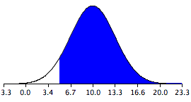
Calculations
Mean = 10
Shaded Area = 0.934
Mean = 10.0
Mean₁ - Mean₂ = 5.0
Notes:
Here is the sampling distribution of the difference between the means. Notice that it is normally distributed with a mean of 10 and a standard deviation of 3.317. The area above 5 is shaded.
The last step is to determine the area that is shaded. Using either a Z table or the normal calculator, the area can be determined to be 0.934. This means that the probability that the mean of the sample from Species 1 will exceed the mean of the sample from Species 2 by 5 or more is .934.

Slide 213
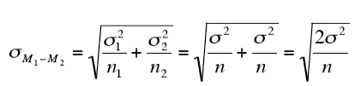
Equal Sample Sizes
The formula for standard deviation simplifies with equal sample sizes:
Notes:
As shown here, the formula for the standard error of the difference between means is much simpler if the sample sizes and the population variances are equal. Since the variances and samples sizes are the same, there is no need to use the subscripts 1 and 2 to differentiate these terms. The standard error of the difference between means is the square root of twice the variance divided by the size of each sample.

Slide 214


15 Year-old Beings From Earth
8 boys
Mean Height: 175
Variance of Height: 64
8 girls
Mean Height: 165
Variance of Height: 64
Notes:
This simplified version of the formula can be used for the following problem: The mean height of 15-year olds boys (in cm) is 175 and the variance is 64. For girls, the mean is 165 and the variance is 64. If eight boys and eight girls were sampled, what is the probability that the mean height of the sample of girls would be higher than the mean height of the boys? In other words, what is the probability that the mean height of girls minus the mean height of boys is greater than 0?

Slide 215

Calculations
Mean = 165-175 = -10
Notes:
As before, the problem can be solved in terms of the sampling distribution of the difference between means (girls minus boys). The mean of the sampling distribution is 165 - 175 = -10. The standard deviation of the distribution is 4, as shown.

Slide 216
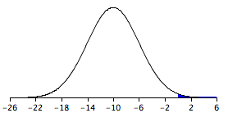
Calculations
Mean = -10
Shaded Area = 0.0062
Mean = -10.0
Mean₁ - Mean₂ = 0.0
Notes:
Here is a graph of the sampling distribution of the difference between the means. From this graph we see that it is unlikely that the mean height for girls would be higher than the mean height for boys.
Specifically, a difference between means of 0 is 2.5 standard deviations above the mean of negative 10. The probability of a score 2.5 or more standard deviations above the mean is 0.0062.
It is therefore unlikely but not inconceivable that the girls' mean would be higher than the boys' mean.

Slide 217
Sampling Distribution of Pearson’s r
Population correlation = 0.60
Different samples yield different values of r
The distribution of r after repeated samples is the sampling distribution
Notes:
Like all statistics, Pearson’s r has a sampling distribution. Different samples will result in different values of Pearson’s r. Assume that the correlation between quantitative and verbal SAT scores in a given population is 0.60. In other words, rho = 0.60. If 12 students were sampled randomly, the sample correlation, r, would not be exactly equal to 0.60. Naturally, different samples of 12 students would yield different values of r. The distribution of values of r after repeated samples of 12 students is the sampling distribution of r.

Slide 218
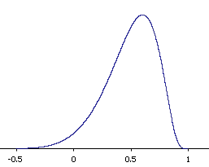
Shape of the Distribution
Notes:
This figure shows the sampling distribution of r when rho (the population correlation) is 0.60 for a sample size of 12. You can see that the distribution has a negative skew. The upper tail of the distribution is limited by 1 since correlations can never be larger than one. However, the lower tail extends quite a long way. With such a small sample size, sample correlations below 0 are not rare.

Slide 219

More Skew
Notes:
The larger the population correlation (rho), the larger the skew. This graph shows the sampling distribution for rho = 0.90.

Slide 220

Negative Correlation
Notes:
When rho is negative, the distribution has a positive skew. This graph shows the distribution for rho = -.9.

Slide 221

Fisher’s z’ Transformation
Notes:
Referring back to the SAT example, for which rho = 0.60, suppose you wanted to know the probability that in a sample of 19 students, the sample value of r would be 0.75 or higher. You might think that all you would need to know to compute this probability is the mean and standard error of the sampling distribution of r. However, since the sampling distribution is not normal, you would still not be able to solve the problem. Fortunately, the statistician Ronald Fisher developed a way to transform r to a variable that is normally distributed with a known standard error. The variable is called z' and the formula for the transformation is shown here. The symbol “ln” stands for natural logarithm. The details of this transformation are not important for present purposes. The critical thing is that this transformation produces a variable that is normally distributed.

Slide 222

Standard Error of z’
N is the number of pairs of scores.
Notes:
In order to do any calculations using the sampling distribution of z’, you need to know its standard deviation. The standard deviation of this distribution (also called the standard error of z’) is equal to 1 over the square root of N – 3, where N is the number of pairs of scores.

Slide 223

Calculations
ρ = .60, N = 12, r > .75
.60  0.693
.75  0.973
Standard error =
Notes:
Let's return to the question of determining the probability of getting a sample correlation of 0.75 or above in a sample of 12 from a population with a correlation of 0.60. The first step is to convert both 0.60 and 0.75 to z's. This can be done from the formula shown previously, a table, or an online calculator. The values are 0.693 and 0.973 respectively. The standard error of z' for N = 12 is 0.333.

Slide 224

Notes:
Using the values just calculated, the problem is pretty easy. We have a normal distribution with a mean of 0.693 and a standard deviation of 0.333. We just have to figure out the probability of obtaining a value of 0.973 or higher. The answer can be found directly from the normal calculator. As you can see, it is 0.20.

Slide 225


Proportions
Candidate A
Candidate B
Favored by 0.60
Favored by 0.40
Notes:
In this section we’re going to discuss the sampling distribution of a proportion. We begin with an example:
Assume that in an election race between Candidate A and Candidate B, .60 of the voters prefer Candidate A.

Slide 226









Vote for A
Vote for A
Vote for A
Vote for A
Vote for A
Vote for A
Vote for A
Notes:
If a random sample of 10 voters were polled, it is unlikely that exactly 60% of them, or 6 out 10, would prefer Candidate A. By chance the proportion in the sample preferring Candidate A could easily be a little lower or a little higher than .60. The sampling distribution of p for a sample size of 10 is the distribution of proportions that would result if you repeatedly sampled 10 observations and tallied the proportion that favored Candidate A in each sample of 10.

Slide 227
Voter | Preference
01 | 1
02 | 0
03 | 1
04 | 1
05 | 1
06 | 0
07 | 1
08 | 0
09 | 1
10 | 1
Notes:
The sampling distribution of p is a special case of the sampling distribution of the mean. This table shows a hypothetical random sample of 10 voters. Those who prefer Candidate A are given scores of 1 and those who prefer Candidate B are given scores of 0.

Slide 228
Voter | Preference
01 | 1
02 | 0
03 | 1
04 | 1
05 | 1
06 | 0
07 | 1
08 | 0
09 | 1
10 | 1
p = 7/10 = 0.7
Notes:
Note that seven of the voters prefer candidate A so the sample proportion, p, is 7 divided by 10 or 0.7

Slide 229
Binomial Distribution
Binomial distribution is the distribution of the number of successes
The sampling distribution of p is the distribution of the proportion of successes
Notes:
The distribution of p is closely related to the binomial distribution. The binomial distribution is the distribution of the number of successes (favoring Candidate A, for example) whereas the distribution of p is the distribution of the proportion of successes.

Slide 230
Mean
Mean of binomial
μ = Nπ
Mean of sampling distribution of p
μ = π
Notes:
The binomial distribution has a mean of N times pi where N is the number of trials and pi is the probability of success on a given trial. For the sampling distribution of p, we divide by N to adjust for the fact that we are now dealing with means instead of totals. The mean is pi.

Slide 231


Standard Deviation
Binomial Distribution
Sampling Distribution of p
Notes:
The standard deviation of the sampling distribution of p is the standard deviation of the binomial distribution divided by N.

Slide 232


Back to the Example
μ = π = 0.60
Notes:
Returning to the voter example, π = 0.60 and therefore, the mean of the sampling distribution of p is 0.60. The standard deviation is computed as shown. Note that the sample size (N) is 10.

Slide 233

Normal Approximation
Rule of thumb: the approximation is good if Nπ and N(1-π) are both greater than 10.
Notes:
The sampling distribution of p is approximately normally distributed if N is fairly large and π is not close to 0 or 1. A conservative rule of thumb is that the approximation is good if both N π and N(1 - π) are both greater than 10. The sampling distribution for the voter example is shown here. Note that even though N(1 - π) is only 4, the approximation is still quite good. Unlike the normal distribution, the sampling distribution of p is a discrete rather than a continuous distribution. For our example, with an N of 10, it is possible to have a p of 0.50 and a p of 0.60 but not a p of 0.55.

